Slide 1
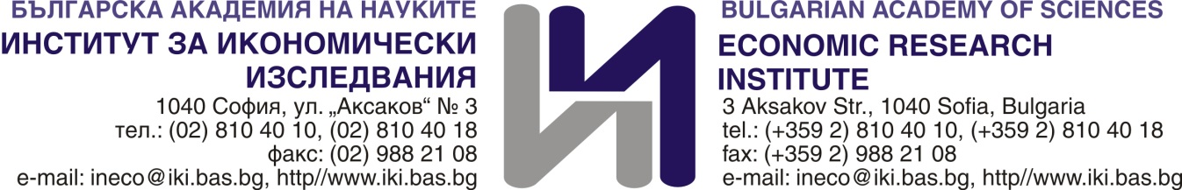
Potential for the Development of the Bulgarian-Chinese Trade and Investment Relations in the context of “16+1”
The Seventh High-Level Think Tanks Symposium of China and Central & Eastern European Countries
26.10.2021
dr. Teodora Peneva

Slide 2
Content
Trade
Investment

Slide 3
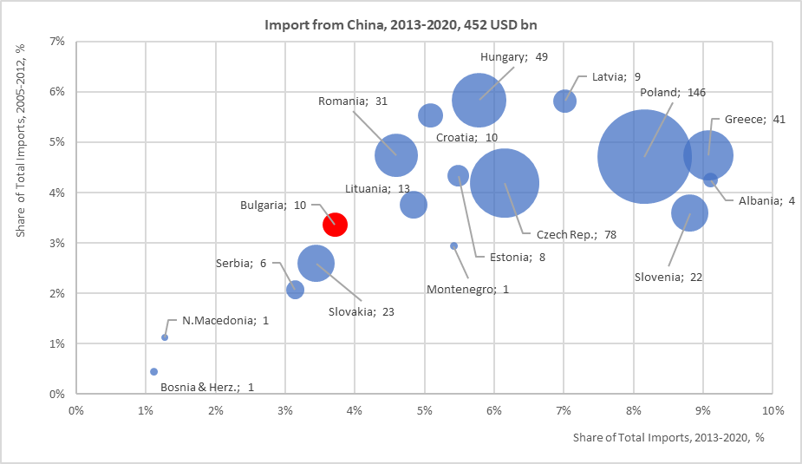
Import from China
USD bn | 2005 | 2010 | 2013 | 2020
Albania | 0,08 | 0,20 | 0,32 | 0,57
Bosnia & Herz. | 0,02 | 0,04 | 0,09 | 0,12
Bulgaria | 0,44 | 0,66 | 1,12 | 1,55
Croatia | 0,57 | 1,34 | 1,39 | 1,57
Czech Rep. | 1,67 | 7,12 | 6,84 | 13,74
Estonia | 0,31 | 0,68 | 1,11 | 0,86
Greece | 1,94 | 3,96 | 3,22 | 7,04
Hungary | 2,49 | 6,52 | 5,69 | 7,40
Latvia | 0,28 | 0,79 | 1,37 | 1,05
Lituania | 0,36 | 0,98 | 1,69 | 1,81
Montenegro | - | 0,07 | 0,09 | 0,11
N.Macedonia | 0,02 | 0,05 | 0,06 | 0,16
Poland | 2,60 | 9,44 | 12,57 | 26,74
Romania | 1,37 | 3,00 | 2,82 | 5,13
Serbia | - | 0,35 | 0,43 | 1,62
Slovakia | 0,31 | 1,96 | 3,08 | 3,03
Slovenia | 0,27 | 1,39 | 1,83 | 3,45
Total | 12,73 | 38,55 | 43,74 | 75,95
Nearly double increase in the annual import value for the region’s trade in the period 2013 – 2020 and individual increase in the share of total imports for almost each country.
Source: ITC, BAS

Slide 4
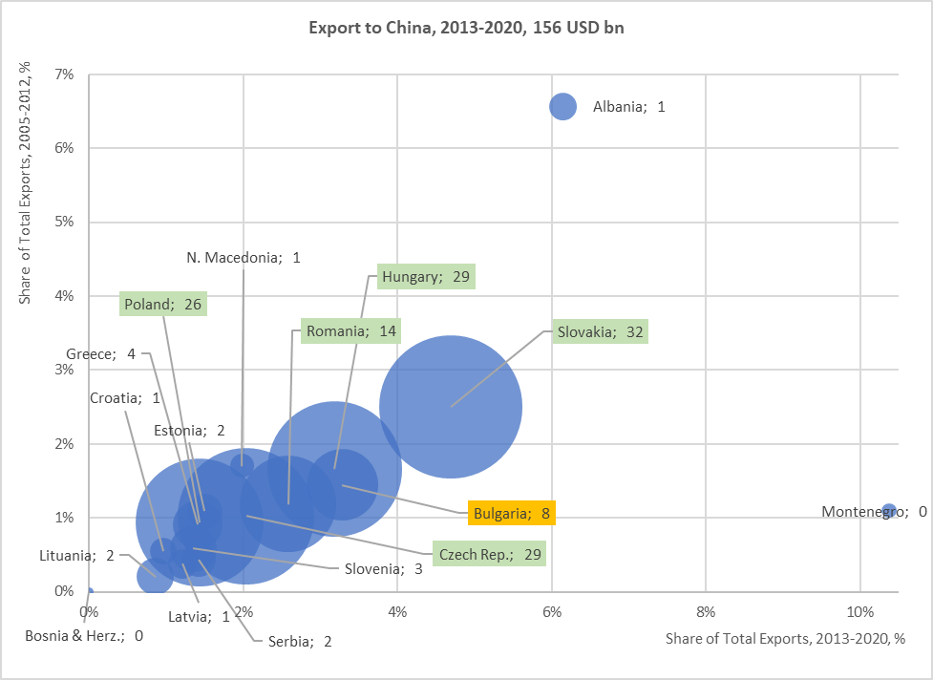
Export to China
USD bn | 2005 | 2010 | 2013 | 2020
Albania | 0,01 | 0,15 | 0,23 | 0,08
Bosnia & Herz. | 0,00 | 0,01 | 0,01 | 0,02
Bulgaria | 0,09 | 0,32 | 0,96 | 1,37
Croatia | 0,04 | 0,05 | 0,10 | 0,14
Czech Rep. | 0,37 | 1,73 | 2,61 | 5,13
Estonia | 0,06 | 0,18 | 0,20 | 0,28
Greece | 0,09 | 0,39 | 0,43 | 0,77
Hungary | 0,37 | 2,20 | 2,72 | 4,28
Latvia | 0,01 | 0,04 | 0,10 | 0,20
Lituania | 0,01 | 0,04 | 0,12 | 0,49
N. Macedonia | 0,01 | 0,09 | 0,11 | 0,23
Montenegro | - | 0,00 | 0,02 | 0,06
Poland | 0,56 | 1,70 | 2,23 | 4,32
Romania | 0,29 | 0,76 | 1,21 | 2,64
Serbia | - | 0,06 | 0,18 | 0,50
Slovakia | 0,18 | 1,79 | 3,46 | 6,43
Slovenia | 0,06 | 0,18 | 0,30 | 0,51
Total | 2,15 | 9,67 | 14,99 | 27,44
Nearly double increase in the annual export value for the region in the period 2013 – 2020 and smaller increase in the share of total imports for almost each country.
Source: ITC, BAS

Slide 5
Trade Balance
Increasing share of the region’s trade in total trade of China with Europe.
Deepening trade deficits of the participating countries in trade with China.
High-tech products are increasing their share in the imports of the whole region.
Increasing share of raw materials in the exports of the region.
Increasing quantity and quality of innovation in the marketing of Chinese companies, and leadership in the latest communication technologies.
144 295
Source: ITC, BAS

Slide 6
Raw Materials Export to China
Poland: 641 mn USD copper in 2020
Bulgaria: 739 mn USD copper in 2020
Serbia: 293 mn USD copper in 2020
Albania: 56 mn USD ores in 2020
Montenegro: 54 mn USD ores in 2020
Bosnia & Herz.: 7 mn USD wood +2,5 mn USD of zinc in 2020
Source: ITC, BAS

Slide 7
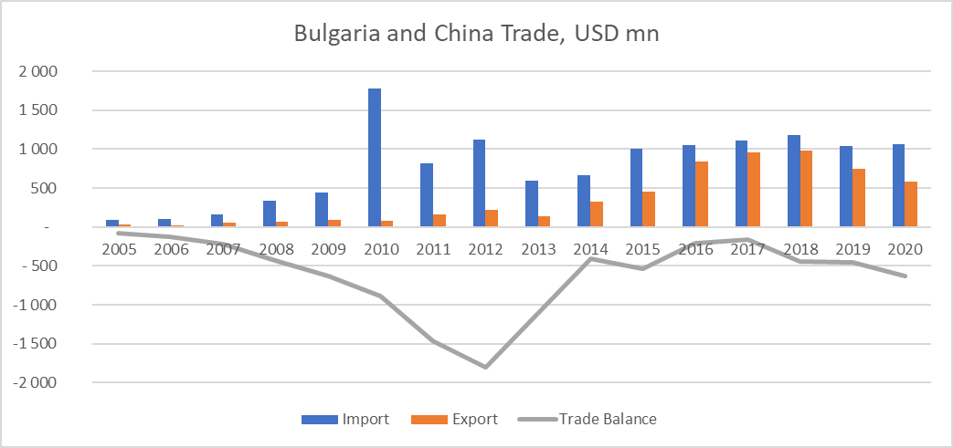
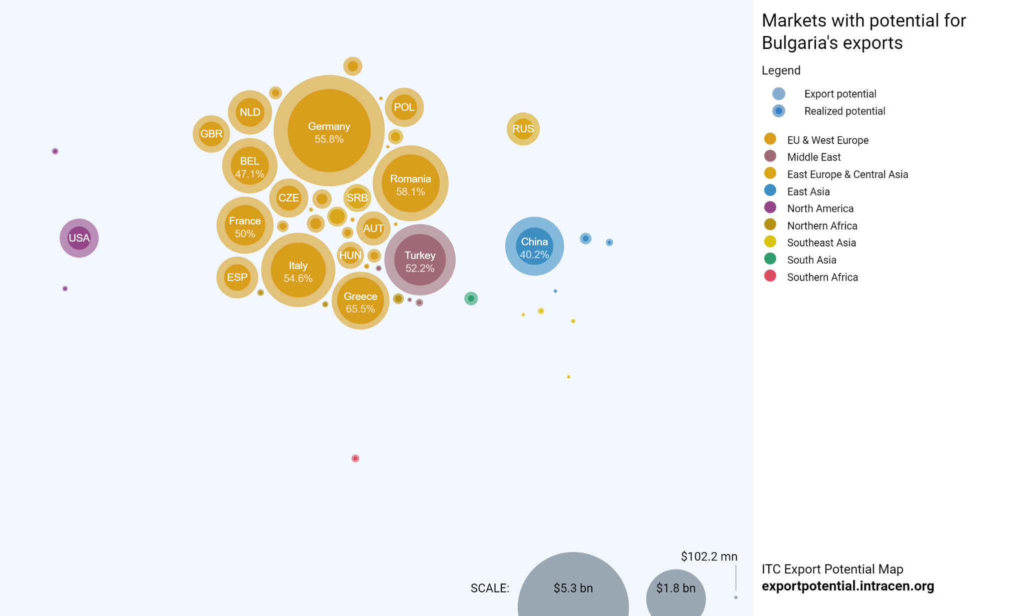
Bulgaria and China Trade
Export from Bulgaria to China
Persistent negative balance.
Dominating exports of raw materials.
Unbalanced export structure.
Unexplored market potential
Source: ITC, BAS

Slide 8
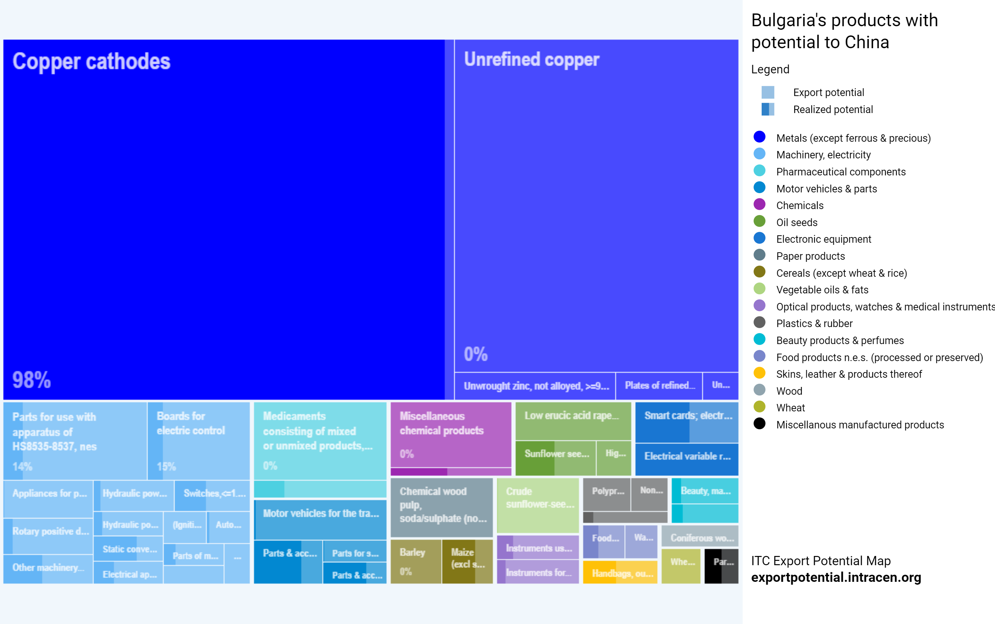
Bulgaria’s Products with Potential to China
Source: ITC

Slide 9
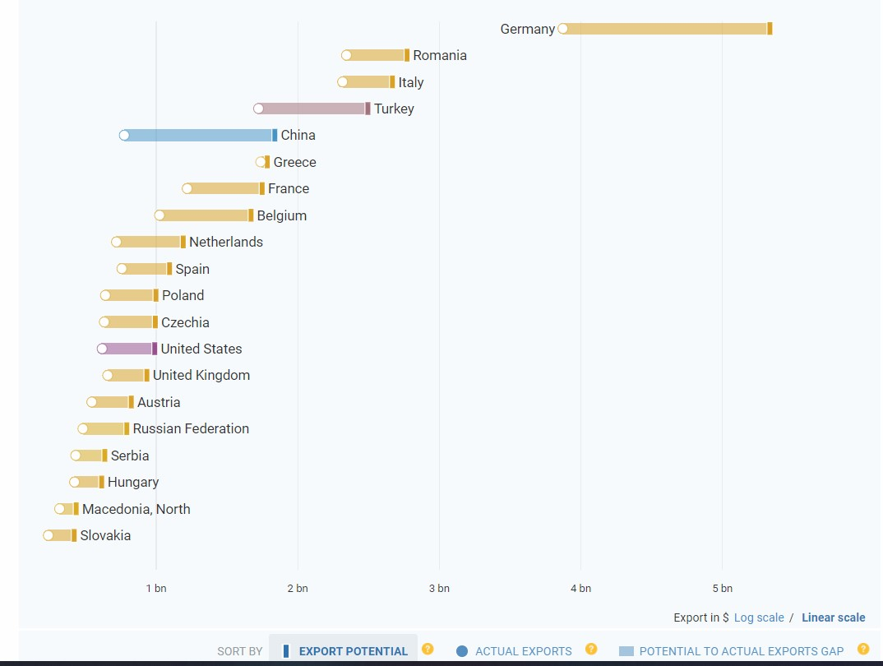
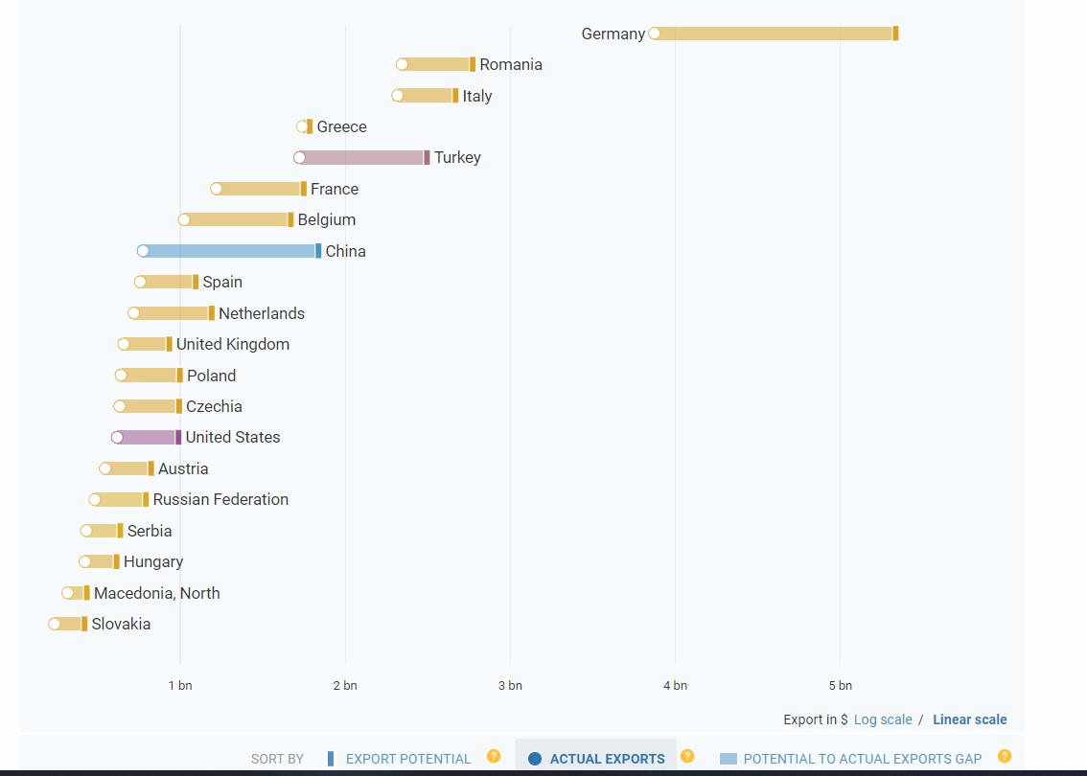
Actual vs. Potential Export from Bulgaria
Actual Export
Potential Export
Source: ITC, BAS

Slide 10
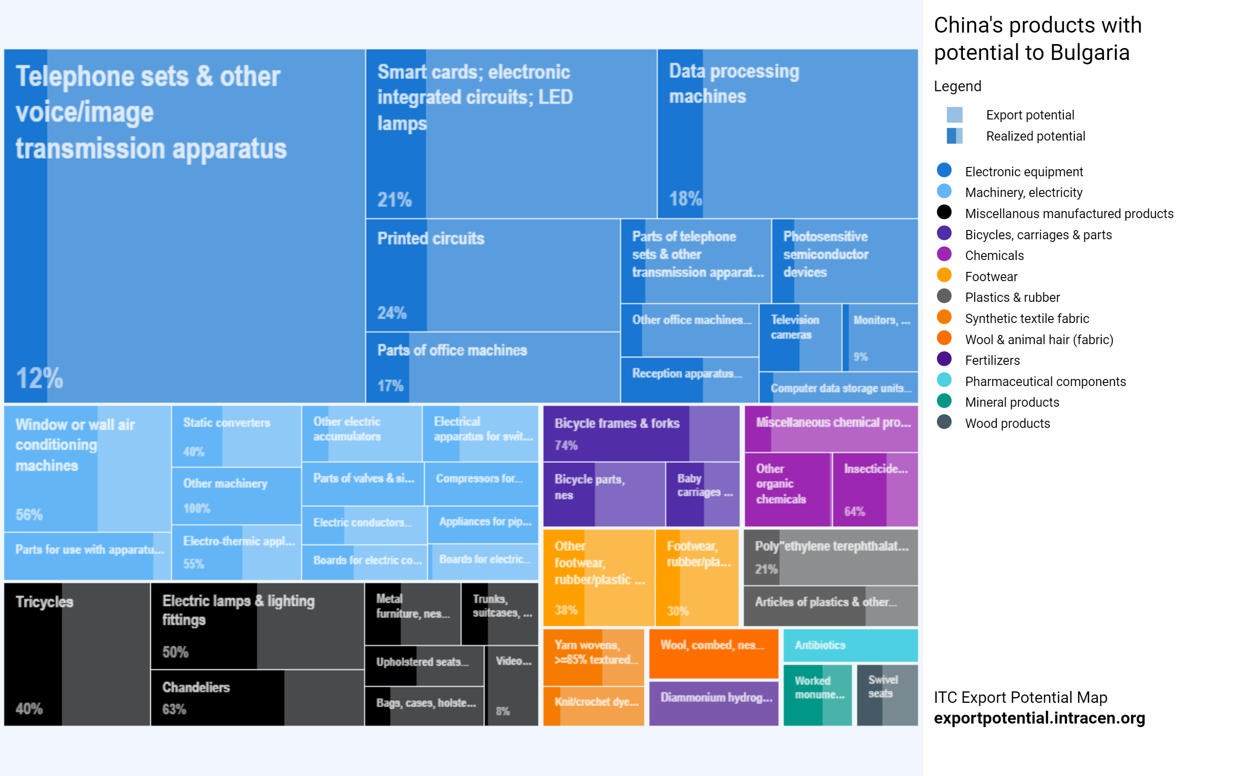
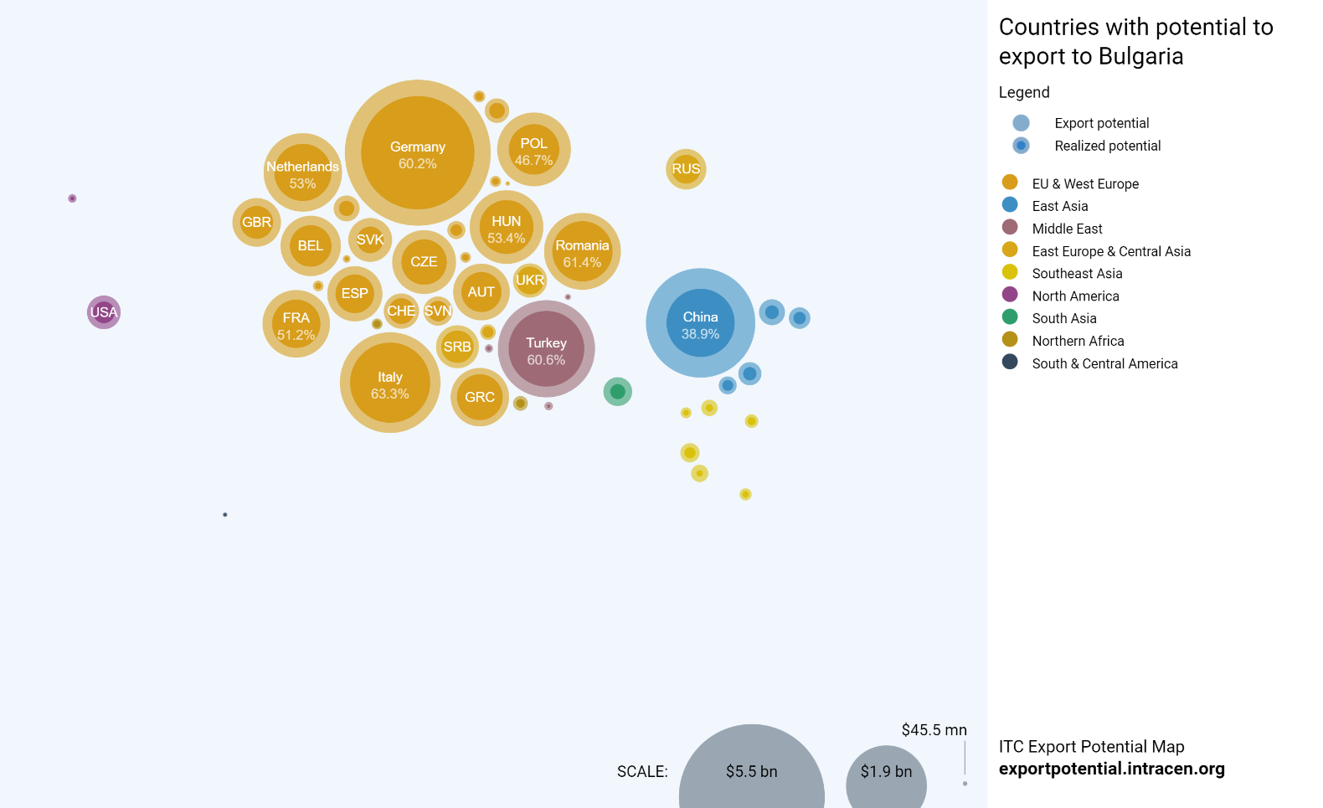
Bulgaria’s Import Potential

Slide 11
Content
Trade
Investment

Slide 12
Chinese Stock Investment in “16+1”EU member countries: 10,9 bn EURO

Slide 13
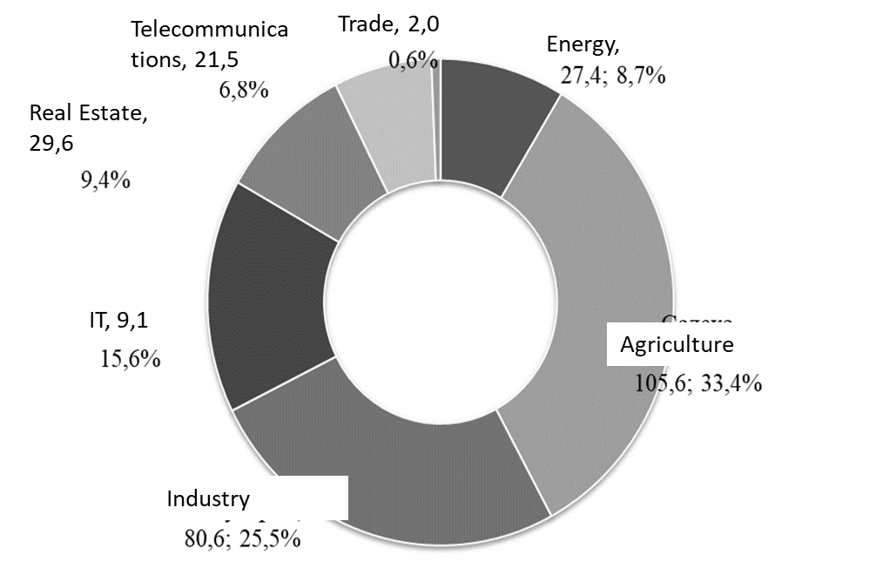
Chinese FDI in Bulgaria
Stock Investment by Sector, mn BGN
Micro Approach: Main Study Results
The investments of up to 20 companies in nearly BGN 315 million of the surveyed (by BAS) companies represent over 90% of the total amount. Secured jobs for 605 employees.
The impact of Chinese FDI depends on sectors. (Prevailing positive results)
Main characteristics: low risk, good investment returns, stability and flexibility!
The structure of the companies’ financing includes: 1) Support from the parent company, 2) Loans from the Bulgarian banking system, 3) Subsidies from European and local programs, 4) Investments in equity participation from Chinese residents and other partners.
Most of the companies are financed by loans from Bulgaria, as interest rates in Bulgaria are lower.
From a macro point of view, investments from China are insignificant in Bulgaria and their effect on the economy on the basis of statistical data could not be assessed.
Source: BAS

Slide 14
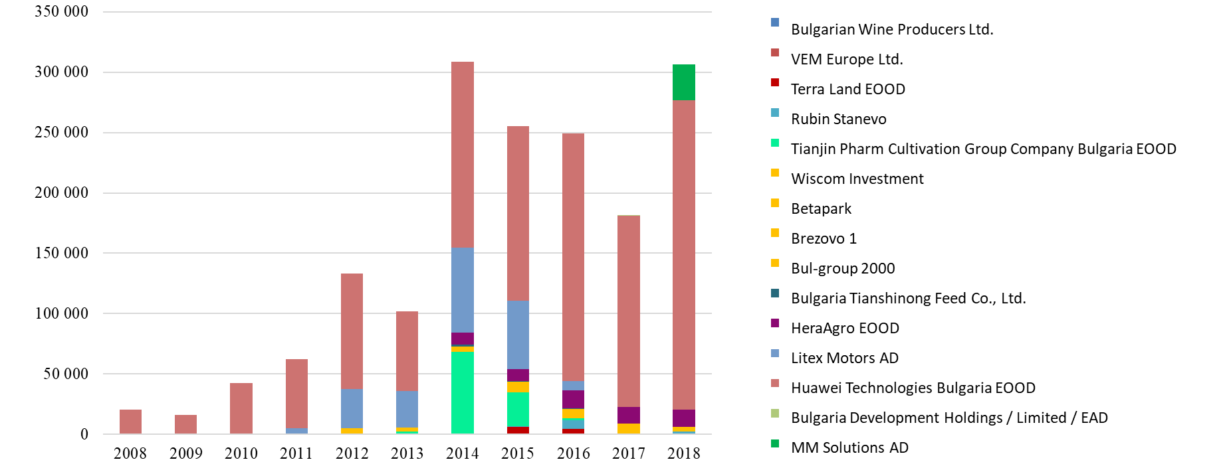
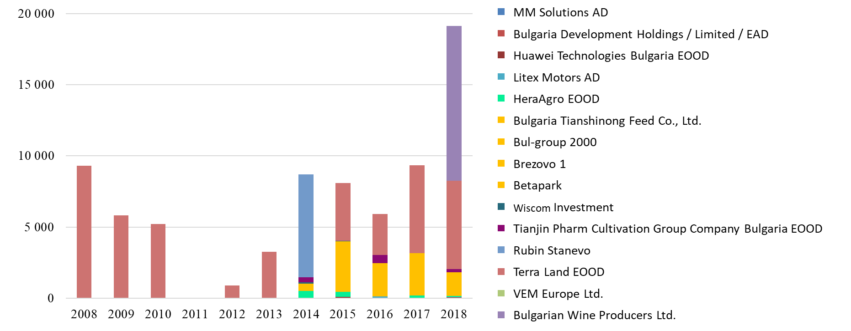
Chinese FDI in Bulgaria
Revenue, thou BGN
With the exception of two companies with more than 10 years of experience, the others are relatively new, so it can be expected that in the first years of their activity no significant revenues and profits are realized.
Profit, thou BGN
Except of Litex Motors, Bulgarian Wine Producers, Bulgaria Tianshinong Feed and Bulgaria Development Holding, the other companies are operating at a profit.
The biggest profit was realized by MM Solutions over BGN 10 million, followed by Huawei Technologies Bulgaria.
Source: annual reports, BAS

Slide 15
Conclusions & Recommendations
Study Results
How to unlock the potential of FDI
Bulgaria has untapped potential to develop trade with China, increasing reciprocity and decreasing trade deficit. Filling the empty containers back to China remains an actual issue.
In Bulgaria mainly benefits can be reported and at this stage there are no risks in terms of national security and other sensitive sectors.
From the grouping of Chinese investments in Bulgaria, according to their motivation, it is clear that investment of all types of motivation have penetrated the country.
On the other hand, the diversification of the flow and the comparison between the different types of investments provide an answer to the question of which are the most profitable investments for the country, so that the policy is directed to them.
The risks of investments with non-market motivation must be taken into account when justifying the policy towards investors.
Changing the perceptions: Convergence of theories, definitions, statistics; more impact assessment and research.
Reducing administrative burden and obstacles to both FDI in China and FDI from China.
Strengthening economic interests related to the organization of logistics of trade routes and production and processing of raw materials.
Acknowledging the quick and high return on investment of energy projects in Bulgaria, thus - Green Investment feasibility.
Increasing China’s role in the post-COVID economic recovery and Chinese inward and outward investment may play a role. Therefore - recovery of frozen projects, implementation of new ones with completed feasibility studies.
Increasing the focus on cultural factors and those related to good political relations to motivate Chinese investment abroad.

Slide 16
Bulgarian People Speaking Chinese
In Bulgaria in 2018 there were an average of 4,000+ people studying in Chinese.
Low investments - high results - Bulgarians are one of the best Chinese speakers, with the highest results in competitions and universities
In Bulgaria we have early achieved the goal that 2016 the UK sets for 2020 - to invest 10 million pounds and have at least 5,000 people speaking and communicating in Chinese. For a much lower cost.
10+
PhD
40+
Masters
500+
Bachelors
4000+
Educated in high schools and courses in 2018

Slide 17
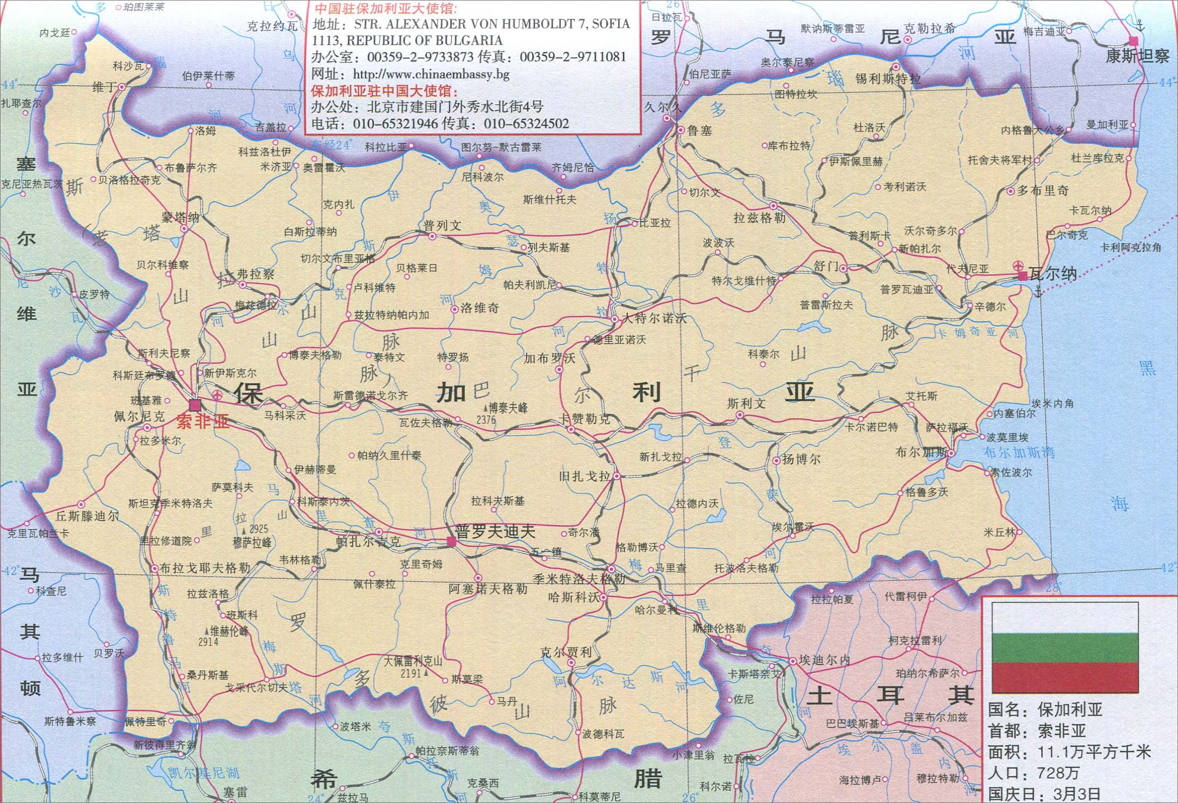
Bulgarian People Speaking Chinese
2000 人 – 索菲亚孔子学院
2000 人 – 达特孔子学院
200+ 人 – 普大
大学
中学/孔子需要

Slide 18
Thank you!

