Slide 1
2015/16 Korea-Bulgaria Knowledge Sharing Program
Governance Innovation for SOEs in Bulgaria
: Based on Korean Experience
Review of SOEs sector in Bulgaria
Mitko Dimitrov
Economic Research Institute
Bulgarian Academy of Sciences
Feb. 24, 2016
Ministry of Strategy and Finance of Korea
Korea Development Institute (KDI)
Economic Research Institute at the Bulgarian Academy of Sciences

Slide 2
Table of Contents
Why state owned enterprise sector is important for Bulgaria ?
What are the strengths and weaknesses of SOEs in Bulgaria ?
Why the current governance system fails ?
Where to find the good practices in SOEs management?
Is a radical reform needed and is it possible?

Slide 3
Why state owned enterprise sector is important for Bulgaria
After a prolonged and hesitant privatization process public sector in Bulgaria diminished to 157 companies where the state participation is more than 50%.
SOEs contribute about 5% of GDP and employ about 7% of labour force
They are concentrated in key sectors of the economy and take decisive market share in energy, transportation, water supply and utilities
SOEs play a major role in provision of public good being majour supplier in several sectors such as medical services, postal services, railway transportation, information services, etc.

Slide 4
Why state owned enterprise sector is important for Bulgaria
SOEs contribute to the state budget
A strong instrument in implementing government policies
Concentrated in sectors with controlled prices
Playing an important role in tripartite system of industrial relations
Supporting functions to other sectors
Partnering with private sector companies

Slide 5
Why now we deal with SOEs ?
The recent crisis calls for searching sources for speeding up the economic growth and the SOEs may be direct and indirect contributor to the GDP growth
The poor performance of the SOEs during the crisis AND BEFORE THE CRISIS need to be addressed
The important role of SOEs for the private sector development also requires relevant policies
Stopped privatization in the last five years. Almost no privatization deals were concluded
There were attempts to provide capital support to SOEs and even to reestablish SOEs
The recent IMF Article IV report also emphasize that the weaknesses in SOEs governance pose risk for the economic and financial stability;

Slide 6
The strengths of SOEs in Bulgaria
Most of the SOEs are commercialized and work under the same rules as private sector companies
No state aid except few cases
High level of autonomy
Broad sectoral structure
Access to financing
High social and industrial relations standards

Slide 7
The weaknesses of SOEs in Bulgaria: limited information
NSI does not provide regular statistics on SOEs
There is no public information and comprehensive analysis on the overall SOEs sector
Not sufficient presentation of the role and specifics of SOEs
Unclear justification as to why the state should or shouldn’t own an enterprise
no clear distinction between the commercial and social functions of SOEs and the relevance of remuneration for the social ones
SOEs are not sufficiently transparent

Slide 8
The weaknesses of SOEs in Bulgaria: poor financial and market performance
The performance in general is weak although diverse performance
Diminishing role of SOEs in the overall GDP and employment is a result of the poor performance.
There are evidences that SOEs do not perform efficiently and the profitability is very low.
According to the 2014 financial reports of the 152 companies with state participation over 50% the net loss is 739 m BGN (496 m BGN in 2013). The main source of this loss is the National Energy Company. Being the only sector where state enterprises prevail this sector is the main source of financial losses.
60 SOEs were on loss, 5 with zero profit.
Most of the SOEs are highly indebted. Three companies have debts over 1 bln BGN (National Electric Company – 3.5 bln BGN, National Railway Company – about 2 bln BGN and Bulgarian Energy Holding – 1.2 bln BGN). Almost all companies in the energy sector are over indebted.

Slide 9
The weaknesses of SOEs in Bulgaria: Unpredictability of dividend policy
Income form dividends (м BGN ) | 2014 | 2013 | 2012 | 2011 | 2010 | 2009 | 2008 | 2007
Consolidated fiscal framework | 66,03 | 511,69 | 303,28 | 188,35 | 170,77 | 340,01 | 96,15 | 161,57
National budget | 57,36 | 502,46 | 290,24 | 173,97 | 156,57 | 320,76 | 80,19 | 151,82

Slide 10
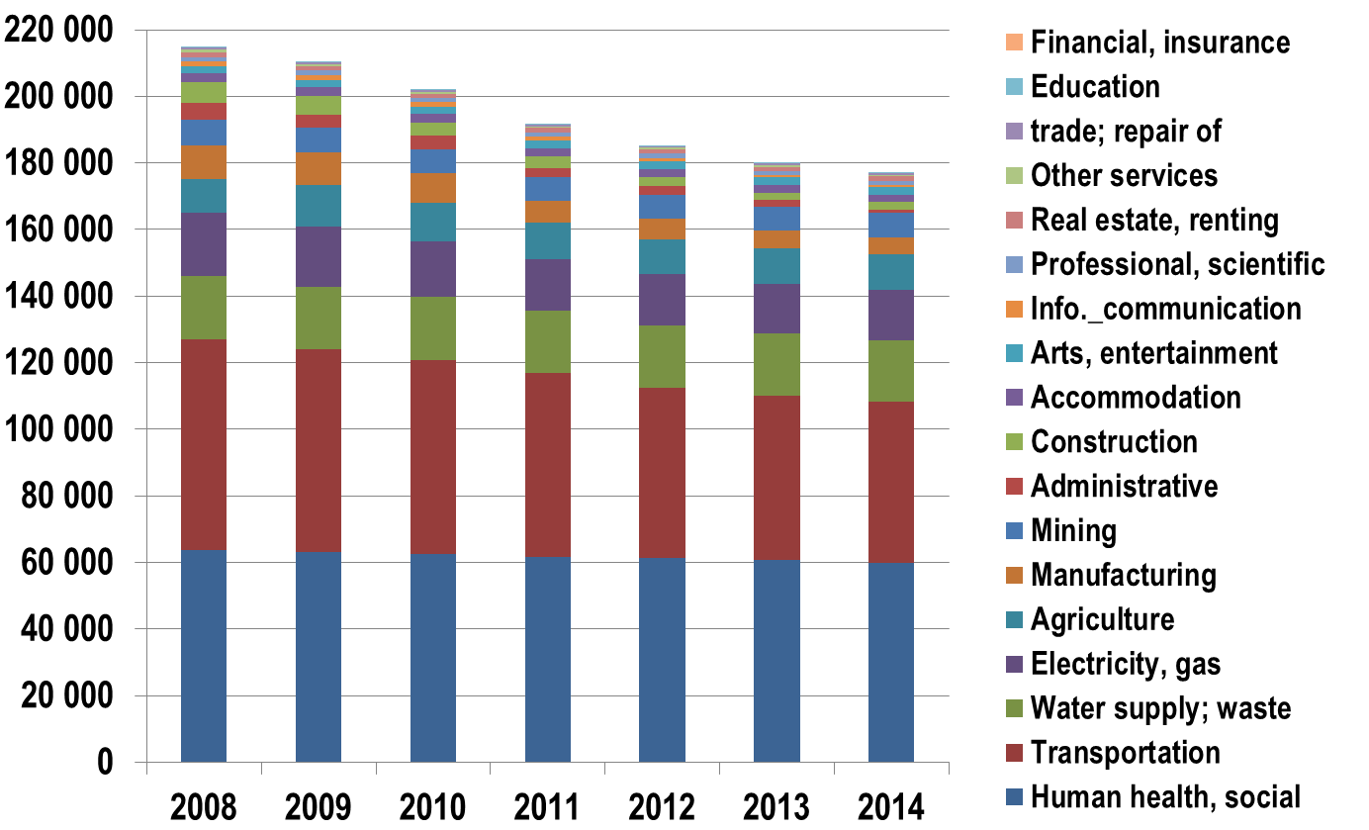
The weaknesses of SOEs in Bulgaria: declining employment

Slide 11
Why the current governance system fails ?
Fragmented and often changed legal framework for SOEs
Since 2010 the financial performance of SOEs is subject of regular monitoring and analysis according to regulation 114/2010 of the Council of Ministers. The regulation has failed to deliver stricter control on financial performance
The autonomy was misused by many enterprises
Recently, two reports of the Bulgarian National Audit revealed that the line ministries do not efficiently exercise their responsibilities in managing state participation in the companies: in many ministries there are no internal rules for the control over their performance, for the monitoring of business programme, for the evaluation of management, etc.

Slide 12
Why the current governance system fails?
Institutional framework for SOEs in Bulgaria was changed several times starting from a more strong Council of Ministers control on the key SOEs to a fully decentralized structure where the ministers exercise fully the state ownership rights.
One of the main changes in the last years was the establishment of holding companies in the sectors controlled by the state, like energy and road infrastructure.
Most of the ministries have in their structure special divisions that deal with SOEs. Their primary objective is to support the minister in his capacity of representing the owner (the state) in the SOEs
Board of directors and the CEOs are directly employed without selective procedure and clear job requirements.
The management is subject to frequent changes rarely motivated by political preferences rather than the performance of the companies.

Slide 13
Why the current governance system fails: inefficient internal and external audit implementation
Internal audit in state-owned enterprises is carried out according to the Law on Internal Audit in the public sector (Prom. SG. No..27 of March 31, 2006).
Under the law, all state-owned companies should have internal auditors who should have special education and qualification.
Large state enterprises and designated as ‘enterprises operating in the public interest’ from the following sectors: energy, trade and transit of natural gas, water, sewage and telecommunications services, and the "Bulgarian State Railways" - EAD and its subsidiaries must have an audit committee
External Audit of state enterprises is done by selected by the AGM auditors and by the Bulgarian National Audit Office (BNAO). The BNAO audits are performed according to the annual program.
BUT
The existing legal framework is inefficient demonstrated by the large discrepancies with the findings of BNAO

Slide 14
Why the current governance system fails: wrong dividend policy
The state drains the dividend from the enterprises
In the last years the budget collected from 60 to 80% (after taxation) of the dividend, which is an extremely unfavorable policy as compared to the OECD counties.
Furthermore, a more stringent policy is applied to some SOEs which perform well: for example for the Sofia Airport Ltd, the share from the profit provided to the budget is 90%.
In some years the state as the owner of the SOEs established too flexible dividend policies listing 10 SOEs for which additional sum (beyond the 80%) had to be provided to the state budget (Regulation № 285/2013 of the Council of Ministers).
Unpredictability of dividend policy does not give room for the SOEs to plan better their finance and investments

Slide 15
Where to find the good practices in SOEs management?
OECD new Guidelines for the management of SOEs – November 2015
The EU experience: the EU SOEs management falls within the competence of DG Industry and subject
The EU member states broadly implement OECD guidelines and recently most of them also consolidated the institutional structure of the SOEs governance ( closing down and merging privatisation authorities with the SOEs management bodies)

Slide 16
Where to find the good practices in SOEs management: Why Korean experience
Strong contribution of Korean SOEs to the GDP
Efficient management evaluation system
Good performance of majour SOEs in Korea that in Bulgaria have a long history of miss performance
Similar sectoral structure of SOEs sector in Bulgaria and Korea
Transparency of Korean SOEs
Focus on the customers attitudes towards SOEs
Identified synergies

Slide 17
Is a radical reform needed ?
YES

Slide 18
Is a radical reform possible?
???

