Slide 1
2015/16 Korea-Bulgaria Knowledge Sharing Program
Governance Innovation for SOEs in Bulgaria
: Based on Korean Experience
Jin Park
KDI School of Public Policy and Management
Feb. 24, 2016
Ministry of Strategy and Finance of Korea
Korea Development Institute (KDI)
Economic Research Institute at Bulgarian Academy of Sciences

Slide 2
Presenter
Jin PARK, Ph.D. (Professor of KDI School)
1987 : B.A. in economics, Seoul National University
1991 : Ph.D. in economics, Univ. of Pennsylvania
1992~1998 : Research fellow, KDI (Korea Development Institute)
1998~2001 : Director, Administrative Reform Team,
Ministry of Planning and Budget
2012~2013: Director, Research Center for State-Owned Enterprises
2001~ : Professor, KDI School
Experience in international consulting:
Vietnam (2015), Myanmar (2015), Guatemala (2010), Namibia (2009), Indonesia (2008~2011),Turkey (2007), Georgia (2004)
Fields: Public Sector Reform, SOEs, Economic Development

Slide 3
Table of Contents
1. Governance of Public Institutions
2. Management Evaluation of Public Institutions
Notes:
3

Slide 4
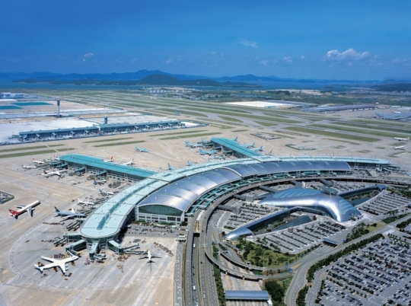
Incheon International Airport Corporation
Best Service Airport 10 years in a row by ACI

Slide 5
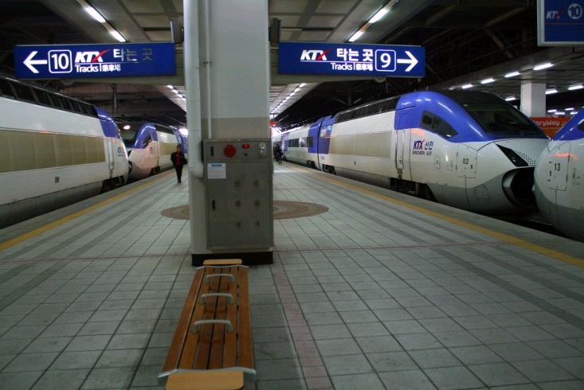
KORAIL (Korea Railway Corporation)
One of world’s highest on-time arrival rate

Slide 6
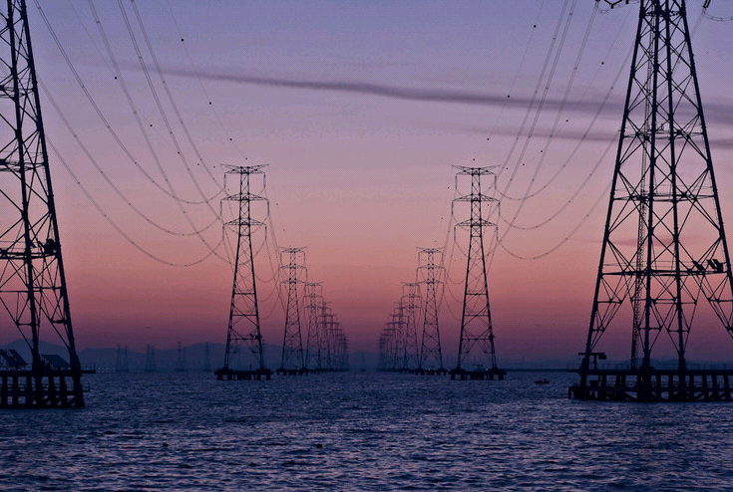
KEPCO (Korea Electricity Power Corporation)
World lowest Black-out Rate

Slide 7
Public institutions (total 323 as of 2016)
Tight Control by MOSF including evaluation
Public Corporations (30) |  | Quasi-government organizations (90) |  | Non-classified public institutions (203) 20 < Staff # < 50
Market-based | Quasi-market -based | Public Fund- Managing PIs | Service- providing PIs
Self-generating revenue≥85% | Self-generating revenue≥50% | Self-generating revenue≤50%
Budget : about 40% of GDP (larger than the central government’s budget)
Workforce (279,423 as of 2015): 1% of the economically active population (40% of the civil servants, teachers and military excluded)
Electricity, Gas, Oil, Highway, Railway, Port, Airport, Water, Housing, Finance…

Slide 8
30 SOEs in Korea (2016)
market- Type (14) | Incheon International Airport Corporation Korea Airports Corporation Korea Gas Corporation Korea National Oil Corporation Korea Electricity Power Corporation Korea District Heating Corporation Korea (Mineral) Resources Corporation 6 Electricity Power Plant Corporations Busan Port Authority
semi- market Type (16) | Yeosu-Gwanyang Port Authority Korea Land and Housing Corporation Korea Expressway Corporation Korea Water Resources Corporation Korea Railroad Corporation Incheon Port Authority Korea Housing (Financial) Guarantee Corporation Korea Tourism Organization Korea (Real estate) Appraisal Board Korea Broadcasting Advertisement Corporation Korea (Horse) Racing Agency Jeju Free International City Development Center Korea Marine Environment Management Corporation Ulsan Port Authority Korea Minting & Security Printing Corporation Korea Coal Corporation

Slide 9

Management System
People, Media
National Assembly
Audit Office
Management information disclosure (www.alio.go.kr)
Customer satisfaction survey
State Audit
Board of each PI
Internal Checks and Balances
Management Committee for Public Institutions
(Chaired by MOSF minister)
MOSF (Ministry of
Strategy & Finance)
Line Ministries
Experts
Management, Evaluation
Supervising Projects
Notes:
9

Slide 10
Overall Governance for SOEs
 | Option 1 | Option 2
 | Centralized system | Decentralized system by each ministry
+ | Tighter and more efficient management Better for privatization | Flexible management for each SOE
_ | Conflict between the central agency and the line ministries | Collusion b/w the ministry and SOE
Korea’s pick | Traditionally strong central planning agency during economic development (EPB >> BFE >> MPB >> MOSF) Historically, there has been one shareholder ministry.
* Proposal for Bulgaria is underlined option.

Slide 11
Composition of Management Committee
 | Option 1 | Option 2
 | All government officials | Government officials + Experts in the private sector (professors, public accountants, lawyers)
+ | Confidentiality | More transparency Use of expertise
_ | Collusion between ministries Less transparency | Sometimes the government cannot control the outcome of the meeting.
Korea’s pick | Option 2. The experts may not be fully autonomous when there is a pressure. Labor union’s participation is an issue now.

Slide 12
Who should be the central agency?
 | Option 1 | Option 2 | Option 3
 | A budget ministry | A ministry in charge of economic policy | An independent Coordination Committee with its own secretariat
+ | effective control thru budget | More knowledge on SOEs | Broader perspective Higher neutrality
_ | May increase debt of SOE to save national budget | May have too many SOEs (neutrality issue) | Less knowledge on each SOE
 | Option 1 (Ministry of Strategy and Finance, MOSF) in Korea MOSF = Ministry of Planning and Budget + Ministry of Finance and Economy

Slide 13
Coverage of central governance
 | Option 1 ? | Option 2
 | SOEs and quasi-government org (state-enterprises) together | SOEs by one central agency Other state-enterprises by each line ministry
+ | Consistent and universal management Unclear line between SOE and others | Different characteristics b/w SOEs and others, different treatment
_ | Too much work for central agency Identical treatment for different entities | Loose management of state-enterprises
Korea’s pick | Option 2 before 2007, but Option 1 after 2007 QGOs were very inefficient compared to SOEs in early 2000s.

Slide 14
4. Framework of MOSF management
Tools of the Central Agency (MOSF of Korea)
The Act on the Management of Public Institutions : framework act (2007)
- The framework act regulating general operation of public institutions
- Defining the roles of the government as the ownership organization
2. The Management Committee for Public Institutions
- Making decisions in regards to management of Public institutions as the top decision making body
- Chaired by the Minister of Strategy and Finance, and composed of government officials and private experts
3. Management information disclosure by public institutions
- Opening the current management status to the public by releasing 37 major items related to management at the website of public institutions info. disclosure system (www.alio.go.kr) for all 323 PIs
Notes:
14

Slide 15
Ways of Information Disclosure
 | Option 1 | Option 2
 | One on-line site as in Korea (www.aliio.go.kr) | Regulation for homepage of each SOE
+ | Each to compile and compare data | Less costly
_ | Difficult to supervise and manage the information | Difficult to compare SOEs
Korea’s pick | Option 1 since 2005 in Korea. In the earlier period, the info was not easy to find and understand. Many inconsistency between the Alio and the homepage of each SOE. After 2014, MOSF established a unit in charge of the Alio system to see much improvement.

Slide 16
4.Evaluation of management by public institutions
- evaluated by the evaluation team composed of private experts
- Based on the evaluation result, differentiated incentive levels are set
5. Executive personnel of public institutions
- Candidates are invited through public announcement (in many cases, pre-arranged)
>> screened and recommended by ad hoc Recommendation Committee
>> screened by Management Committee for PI (narrowed down to 2-3)
>> Recommended by MOSF and appointed by President (or appointed by the Minister)
- The Board of directors composed of no more than 15 with non –
standing directors exceeding a certain level
 | To be evaluated
SOE | Management results of the previous year by public corporations and quasi-governmental institutions
CEO | Compliance level of the management plan by an institution head with more than 6 months in his office
Notes:
16

Slide 17
How to appoint the CEO?
 | Option 1 | Option 2
 | Public announcement for open recruitment, and then recommended by a Committee | Direct appointment without such process
+ | Fair process Reduce the burden of the appointer | Efficient and quick Respect for the appointment power Higher accountability
_ | May ineffective (when the appointer has someone in mind) Takes longer period | Possibility of wrong selection
 | Option 1, but sometimes ineffective.

Slide 18
Who appoint the CEO?
 | Option 1 | Option 2
 | Political leader (President or Prime Minister) | Minister
+ | Elected political leader’s legitimate exercise of his/her power | Stronger control by each ministry
_ | Too much concentration of power | May be influenced by the political leader
Korea’s pick | For SOEs, option 1. For QGOs, option 2. But option 2 is sometimes not respected by the President.

Slide 19
Members of Board of Directors
 | Option 1 | Option 2
 | All outsiders except CEO (All outsiders are non-standing, one of whom is chairman) | Mixed (CEO + standing vice-CEOs + non-standing outsiders)
+ | Strong check and balance
_ |  | Non-standing outsiders may not be useful.
Korea’s pick | Option 2 for most of SOEs Option 1 for 4 Port Authorities

Slide 20
6. Budget and workforce management of public inst.
- (Budget) Managing labor costs and ordinary expenses through budget compilation guidance and budget enforcement guideline
- (Workforce) Managing the workforce through regular deliberation on institutions’ functions and the size of their workers. Each organization needs MOSF’s approval when they want more staffs.
7. Customer satisfaction survey
- Releasing the survey results from customers who have used services
provided by public institutions (private research enter)
8. Remuneration management
- Managing total labor cost of an SOE, annual compensations of executives and audit officers through relevant guidance
- Annual Bonus depends on the result of the management evaluation by MOSF
Notes:
20

Slide 21
Control for the Projects
 | Option 1 | Option 2
 | Approval of major big projects by pre-feasibility study (with or w/t government budget) | Approval of projects only with government budget
+ | Tighter control of projects | Higher accountability of SOEs
_ | Lower autonomy of SOE | Useless provision (Most of projects by SOEs does not carry government budget)
Korea’s pick | Option 2 until 2012, but option 1 after 2013 Pre-feasibility study: any projects over 50 million $ should go through pre-feasibility study conducted by KDI commissioned by MOSF

Slide 22
Control over employment
 | Option 1 | Option 2 | Option 3
 | Approval for any new employment by the central agency | Approval by the line ministry | No restriction for # of staffs but with guidelines and evaluation
+ | Tight control | More info than option 1 | Autonomy Accountability
_ | Lack of autonomy Asymmetric info | Collusion | Too much slacks
Korea’s pick | Option 1 but no restriction for selected good performing SOEs (Option 3 makes sense when there is a tight evaluation on the outcome/inputs)

Slide 23
Mandatory customer satisfaction survey?
 | Option 1 | Option 2
 | Mandatory for all SOEs Include the survey result in the management evaluation | Recommended
+ | Strong focus on the customer | Reference for voluntary improvement
_ | Too much costs Disadvantage for certain SOEs (large # of customers, regulating function) | Not much impact
Korea’s pick | Option 1 Currently, however, there is little difference among the results across SOEs. (Almost all SOEs get over 90% points)

Slide 24
9. Function Review
- (Redundancy) Any redundant function of two SOEs?
e.g. Supporting SME’s export by two quasi-government bodies
- (Market function) Any function that can be supplied by the private sector?
e.g. Apartment Sales by LH Corporation, Mineral resource exploration
MOSF reviews functions of SOEs >>> finalized by the management Committee
Bringing Competition
Railway system
Supply of rented apartments by private sector (voucher system)
KEPCO: 6 subsidiaries
Considering market test
Privatization
Even partial sale of government share does not make progress
(Incheon International Airport Corporation)
Notes:
24

Slide 25
Function Review
 | Option 1 | Option 2
 | Continuous process | When there is a new political leadership (every 5 year)
+ | Long deliberation | Big impact
_ | No big change | One time event Lack of time
Korea’s pick | Used to be Option 2 But now Option 1 with a touch of Option 2. (When we have a new president, there is a drive for reforming SOEs.)

Slide 26
10. Fiscal Control
- 5 year-term fiscal planning is mandatory for big SOEs (around 40)
The plan should be approved by MOSF every year, and submitted to the National Assembly.
- Dividend Policy: Currently only 20% of pay-out ratio. (Generally low in the private sector, too.)The government is trying to enhance it to 40% by 2020.
11. Monitoring
- Major policy agenda is monitored every month in the Management Committee. The progress is reflected in the management evaluation.
e.g. Current agenda: Salary Peak System
Last year: Debt, fringe benefits
Notes:
26

Slide 27
Dividend Policy
Korean gov plans to expand the propensity to dividend to 40% by 2020.
 | 2009 | 2010 | 2011 | 2012 | 2013 | 2014
Gov investment (billion USD) | 55.6 | 59.0 | 60.5 | 61.1 | 61.5 | 61.7
Dividend (billion USD) | 0.34 | 0.20 | 0.43 | 0.60 | 0.49 | 0.33
Rate of return for investment | 0.60 | 0.34 | 0.72 | 0.99 | 0.80 | 0.53
Propensity to dividend (dividend/net profit)
19.8% 20.2% 20.4% 24.2% 21.5%
Ways to fix the propensity for each SOE
4 Groups depending on the ratio of self-generated revenue
Quantitative index: profit ratio, debt ratio, reserve ratio
Non-Quantitative index: government support
Notes:
27

Slide 28
1. Governance of Public Institutions
2. Management Evaluation of Public Institutions
(Most powerful tool by the central agency, MOSF)
Notes:
28

Slide 29
History of the evaluation system
’84 ~ ’03
’04 ~ ’07
’08 ~ now
Management Evaluation
on public corporations
Evaluation on SOEs
Evaluation
on public institutions
ME
on quasi-government org
SOEs are easier to evaluate than quasi-government organizations.

Slide 30
Time frame
June (announcement)
September
November
February
September
Public institutions
and
Evaluation team
Public institutions
Evaluation team
SETUP
performance targets performance indicators
REPORT
management performance
EVALUATE
management performance
Consulting for low graders

Slide 31
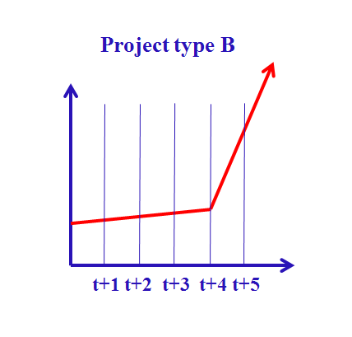
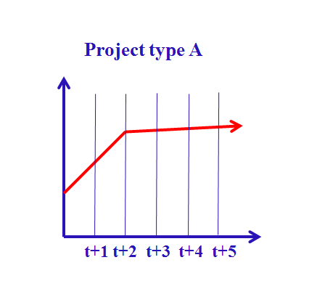

Issues: Myopic horizon
Be in office for the short term (3 years+1+1)
Annual evaluation
Mid-term planning is mandatory

Slide 32

Burden for SOEs
Efforts to improve the evaluation results every year
Prepare for Q&A
Receive consulting
Management evaluation
Write reports
Recommended Policy Index
Current Discussion
The gov considers easing the burden of SOEs.
Task for Korea
provide more
autonomy, but not
much progress

Slide 33
Frequency of Management Evaluation
 | Option 1 | Option 2
 | Annually | Every 3 years
+ | Quick feedback Tool for annual bonus | Longer perspective of CEO
_ | Burden Short-sighted CEO | Low responsiveness
Korea’s pick | Option 1

Slide 34
Imbalance between MOSF & Line ministries
Ministry of
Strategy & Finance
Line Ministry
Management
evaluation
SOEs
Improving SOE management is a process of conflict between
the central agency and the line ministries.
So it needs a support from the political leadership.

Slide 35
Who is in charge of Evaluation?
 | Option 1 | Option 2 | Option 3
 | Central Agency (MOSF in Korea) | Line ministries | Central agency Line ministries
+ | Neutrality | Better knowledge | Harmony b/w ministries
_ | Heavy burden Conflicts with line ministries | Collusion | Division of labor
Korea’s pick | Option 1 (Line ministries used to evaluate the quasi-government org, but impartially higher score for SOEs whose CEOs come from the line ministries.)

Slide 36


Evaluation structure & procedure
Deliberation & resolution
Finalize evaluation method
Management Committee
Finalize
the evaluation result
Approve & finalize
the system improvements
Ministry of
Strategy & Finance
Independent experts
Suggest improvements to be made
Research Center for SOEs
SOEs
Complaints & suggestion

Slide 37

Independence & Neutrality of the evaluation team
Management Committee
Report
Independent experts
Professors
CPAs
Appointment
Guideline
Ministry
of Strategy & Finance
Suggest
improvements
Evaluate
SOEs
Research Center for SOEs

Slide 38
Who actually Evaluates?
 | Option 1 | Option 2
 | Ad hoc evaluation team | Government staffs
+ | Neutrality Easy to conduct in a short period of time | Expertise after a certain period
_ | Weak expertise on SOEs by the team member (professors, CPA) Costs (3 million $ every year) | Collusion Skewed distribution of work load over a year
Korea’s pick | Option 1 since the beginning of the evaluation (UK or France follows option 2) It depends on the level of transparency and neutrality of the government.

Slide 39
Who are to be evaluated?
 | Option 1 | Option 2 | Option 3
 | SOE only | CEO only | SOE and CEO
+ | Simple Good for setting annual bonus for each staff | Simple Good for controlling CEO | Option 1+2
_ | CEO is responsible? | Annual bonus for staffs | Redundancy More costs
Korea’s pick | Option 3 Correlation between SOE and CEO performance is an issue. How to evaluate the following cases? Wonderful CEO of a hopeless SOE, Korea Coal Corporation Terrible CEO of a well-established, systemized SOE, KEPCO

Slide 40
Evaluation indicators
PROCESS
leadership
accountable management
customer satisfaction
social responsibilities
Quantitative
Non-quantitative
Leadership of Standing vice CEOs
INPUT
OUTPUT
Management efficiency
Major businesses
labor & asset productivity
budget & financial management and its performance
remuneration & performance management
labor-management
core business 1(performance)
core business 2(performance)
core business 3(performance)

Slide 41
Evaluation Category
 | Option 1 | Option 2 | Option 3
 | Only output (performance) | Input+Output | Input+process+output
+ | Easy to evaluate (mostly quantitative index) | Easy to evaluate Both input and output | Comprehensive evaluation
_ | Cost side | Transparency Corruption | Process is difficult to evaluate (mostly non-quantitative)
Korea’s pick | Option 3

Slide 42
Success Factor: Balance between objectivity & subjectivity
Take into account exogenous variables that influence quantitative variables
30%
70%
Quantitative
Non-quantitative
Evaluation indicators
Accountable management
Social responsibilities
Labor-management control
Labor & asset productivity
Customer satisfaction
Growth rate in the total
personnel remuneration

Slide 43
Target of Quantitative Indicators
If a SOE does not make progress, it will get grade C.
(grade S)
f(2015)+2σ
(grade A)
(grade B)
(grade C)
(grade D)
f(2015)+σ
f(2015)
f(2015)-σ
f(2015)-2σ
σ
(grade E)
2013 2014 2015 2016 target (evaluated in 2017)
(It used to be 5 years, but reduced to 3 years since 2014)
*σ : Standard deviation of the past three years’ performances

Slide 44
Quantitative or non-Quantitative Indicator
 | Option 1 | Option 2
 | Mostly quantitative | Mostly non-quantitative :Excellent(S)-very good(A)-good(B)-mediocre(C)-poor(D)-very poor(E)
+ | Less controversy Easier evaluation | Overall evaluation
_ | Exogenous variables | More controversy
Korea’s pick | Close to Option 1 It used to be 50:50, but now 70(quantitative):30 (non-quantitative) due to controversies over non-quantitative indicators. For Quasi-government org, 60:40.

Slide 45
Harsh Consequence
＊Performance bonus for each employee
(based on monthly salary)
250%
Penalty to E, D graders
(2 warnings in a row means removal)
S
200%
(0.9~1%)
Warning
A
average distribution
150%
(15.6%~25%)
B
Removal
100%
(43%~45.9%)
C
0%
(16.7%~24.8%)
D
0%
(8%~12.5%)
When your monthly basic salary is 2, 000 USD:
Your annual performance bonus is 5,000$ if you get S 0$ if you get D
E
(1~2%)

Slide 46
Match between external & internal evaluation
Evaluation indicators | Grade
Indicator 1 | A
Indicator 2 | C
Indicator 3 | B
Indicator 4 | D
Indicator 5 | B
Workforce in charge | Performance rating
Mr. Kim in charge of indicator 1 | A
Ms. Lee in charge of indicator 2 | C
Mr. Choi in charge of indicator 3 | B
Ms. Kim in charge of indicator 4 | D
Mr. Lee in charge of indicator 5 | B
This match is not by gov regulation.

Slide 47
Relative or Absolute Evaluation?
 | Option 1 | Option 2
 | Relative | Absolute
+ | Competition | Ideal
_ | More controversies Unequal footing issue (evaluation pool) | All generous result
Korea’s pick | In theory, option 2 (absolute evaluation) but In fact, option 1(relative evaluation) since the final grade has a certain distribution.

Slide 48
Consequence of the Evaluation
 | Option 1 | Option 2 | Option 3
 | CEO re-appointment | Annual bonus of staffs | Both
+ | Easy to implement | Pressure for staffs Control over labor union | Option 1+2 Pressure for both top and bottom
_ | Political decision No pressure for staffs | Less pressure for CEO
Korea’s pick | Option 3 It used to be option 1, but penalty or reward for CEO was introduced after 2008. (term of CEO: 3+1+1)

Slide 49
Governance Model of Bulgaria and Korea
 | Bulgaria now: No Governance | Bulgaria’s future: Collaborative Governance | Korea now: Centralized Governance
Governing structure | Line ministries | Partially Centralized system | Centralized system
Central body | - | Steering Committee with its own Secretariat | Steering Committee with MOSF as secretariat
CEO appointment | Line minister | Political leader or Line minister | Political leader
Input control | None | Ex ante guideline followed by monitoring | Tight ex ante control
Project control | None | All by line ministry | Major projects by the central agency
Evaluation in charge | None | Central agency and line ministries | Central agency
Evaluation frequency | - | Once every three years | Every year
Conse -quence | None | CEO reappointment Annual bonus | CEO reappointment Annual bonus Non-payroll expense

Slide 50
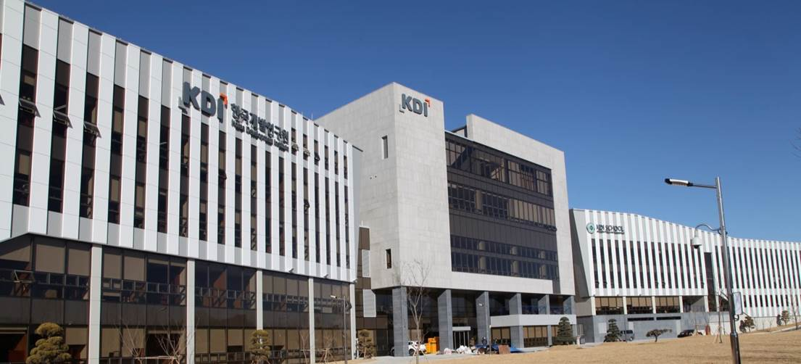
Thank you

