Slide 1
2015/16 Korea-Bulgaria Knowledge Sharing Program
Strategies for Enhancing the Extended Producer Responsibility System in Bulgaria: The Case of WEEE
Anton Ognyanov Peychev
Ministry of Environemt and Water of Bulgaria
Feb. 24, 2016
Ministry of Strategy and Finance of Korea
Korea Development Institute (KDI)
Ministry of Environment and Water of Bulgaria

Slide 2
Table of Contents
Introduction : Why dealing with WEEE EPR for KSP is important
Current Bulgarian EPR status: facts and trends
  2.1. Historical development
  2.2. Stakeholders responsibilities
  2.3. Achievement of target
Critical issues
3.1. System-related
3.2. Regulation-related
3.3. Culture and Education-Related
3.4. Economic Incentives-Related

Slide 3

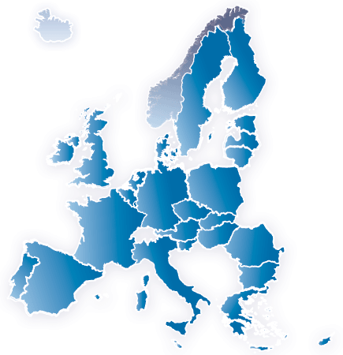

Introduction : Why dealing with WEEE EPR for KSP is important
Bulgaria’s way to EU
Legal framework change transposition of
EU acts and implementation of new principles
Factors on effectiveness of waste managements systems
Benefit from the KSP project

Slide 4
CURRENT STATUS OF BULGARIAN EPR
HISTORICAL DEVELOPMENT
  INITIAL STEPS OF EPR SYSTEM – introduction of EPR for packaging waste, first regulations
  WASTE MANAGEMENT BUDGET – municipal waste financing mechanism, law change (2017)
      (unit: thousands BGN)
      Municipal Revenues and Expenses
    Municipal Waste Collection and Transportation and purchase of waste containers – more than 50%
    Increase of expenses on R&D, Construction, Maintenance, Operation, Closure of Landfills – 18% (2012)
    Season cleaning – around 30%
Revenues and Expenses | 2009 | 2010 | 2011 | 2012
Total Revenue from Municipal Waste Fee | 436 007 | 466 859 | 509 145 | 516 489
Total Waste Management Municipal Expenses | 377 432 | 360 201 | 409 142 | 402 773

Slide 5
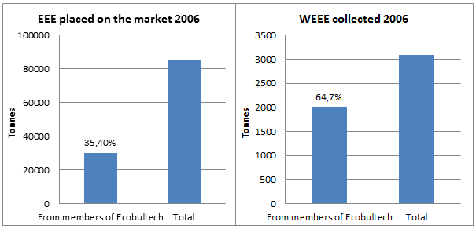
CURRENT STATUS OF BULGARIAN EPR (2)
  EXTENDED PRODUCER RESPONSIBILITY FOR WEEE
    Bulgarian WEEE ordinance – transposition of EU WEEE Directive (Directive 2002/96/EC on waste electrical
    and electronic equipment)
    First WEEE Producer Responsibility Organizations (PRO)
    WEEE PROs in 2015

Slide 6
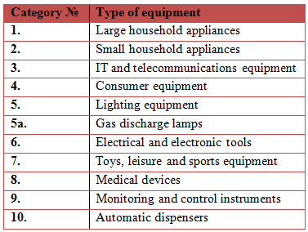
CURRENT STATUS OF BULGARIAN EPR (3)
STAKEHOLDERS RESPONSIBILITIES
    WEEE Directive (Directive 2002/96/EC)
    Scope of regulations - WEEE categories and targets
    EEE producers obligations – design, user information, marking; achieving targets
    Individual compliance and PROs membership
    PROs obligations – collection and recycling of WEEE on behalf of their members
Category | Rate of recovery* | Rate of reuse and recycling
1 and 10 | 80 % | 75 %
3 and 4 | 75 % | 65 %
2, 5, 6, 7 and 9 | 70 % | 50 %
gas discharge lamps |  | 80 %

Slide 7
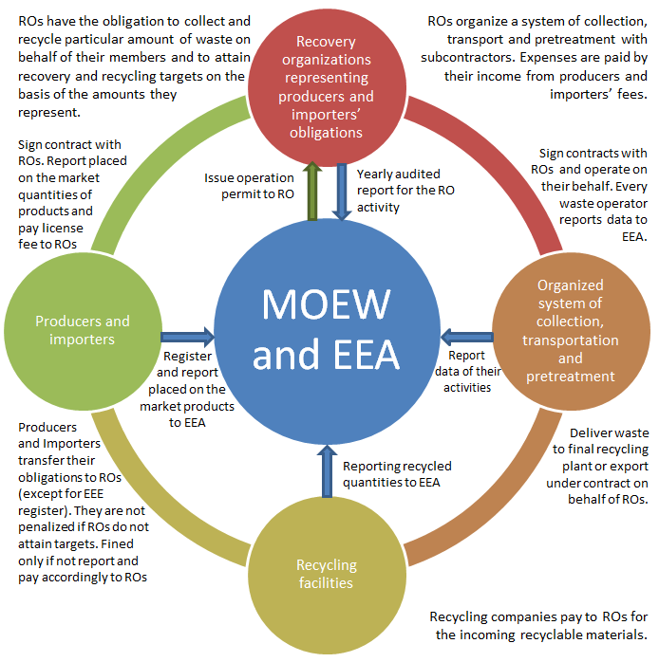
CURRENT STATUS OF BULGARIAN EPR (4)

Slide 8
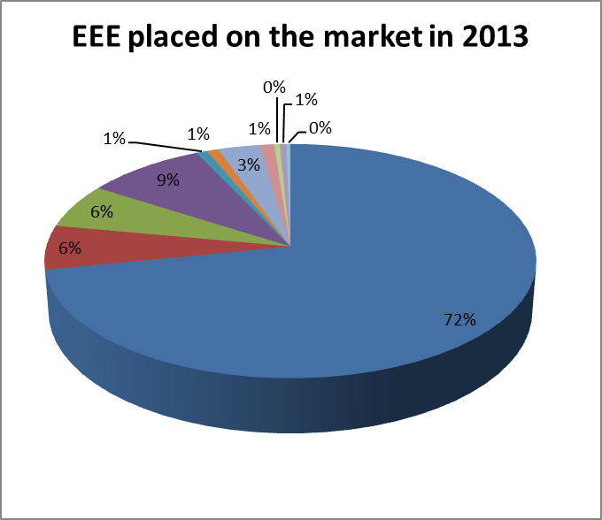
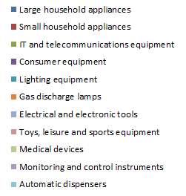
CURRENT STATUS OF BULGARIAN EPR (5)
ACHIEVEMENT OF TARGETS
    Eurostat data (tonnes)
 | Categories EEE put on the market | 2009 | 2010 | 2011 | 2012 | 2013
1 | Large household appliances | 41,097 | 36,381 | 36,607 | 38,652 | 40,732
2 | Small household appliances | 2,537 | 3,100 | 2,879 | 2,616 | 3,462
3 | IT and telecommunications equipment | 3,301 | 3,334 | 3,105 | 3,245 | 3,489
4 | Consumer equipment | 5,631 | 4,881 | 4,743 | 4,482 | 5,009
5 | Lighting equipment | 613 | 478 | 453 | 481 | 469
5a | Gas discharge lamps | 557 | 607 | 423 | 382 | 483
6 | Electrical and electronic tools | 1,061 | 1,423 | 1,859 | 1,814 | 1,768
7 | Toys, leisure and sports equipment | 539 | 233 | 278 | 485 | 606
8 | Medical devices | 291 | 129 | 167 | 204 | 241
9 | Monitoring and control instruments | 223 | 459 | 375 | 572 | 269
10 | Automatic dispensers | 199 | 181 | 285 | 210 | 173
 | TOTAL | 56,049 | 51,206 | 51,174 | 53,143 | 56,701

Slide 9
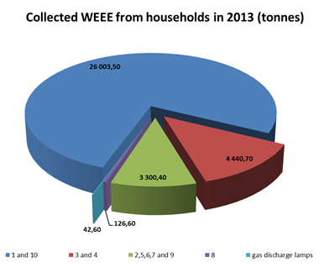
CURRENT STATUS OF BULGARIAN EPR (6)
ACHIEVEMENT OF TARGETS
    Collection of WEEE from households / non-households
    Recovery and recycling targets calculation
    Collected from households
Year | Categores |  |  |  |  | TOTAL BY YEAR (t)
 | 1 and 10 | 3 and 4 | 2,5,6,7 and 9 | 8 | gas discharge lamps
2009 | 28,893.50 | 3,020.50 | 5,375.70 | 145.20 | 160.40 | 37,595.30
2010 | 31,156.90 | 5,102.70 | 5,441.70 | 125.40 | 268.10 | 42,094.80
2011 | 27,837.10 | 3,962.70 | 5,698.90 | 137.90 | 126.00 | 37,762.60
2012 | 25,622.10 | 4,529.00 | 4,236.10 | 105.20 | 63.90 | 34,556.30
2013 | 26,003.50 | 4,440.70 | 3,300.40 | 126.60 | 42.60 | 33,913.80
TOTAL BY CATEGORY | 139,513.10 | 21,055.60 | 24,052.80 | 640.30 | 661.00

Slide 10
CURRENT STATUS OF BULGARIAN EPR (7)
ACHIEVEMENT OF TARGETS
    Recovery, recycling, compared to set targets
Category | Set | Recovery (unit: %)
 | Target | 2009 | 2010 | 2011 | 2012 | 2013
1 & 10 | 80 | 84.79 | 81.41 | 88.71 | 89.10 | 90.9
3 & 4 | 75 | 77.77 | 80.96 | 79.28 | 78.47 | 86.8
2, 5, 6, 7, 8 & 9 | 70 | 71.51 | 74.94 | 80.36 | 80.35 | 84.9
Category | Recycling (unit: %)
 | Target | 2009 | 2010 | 2011 | 2012 | 2013
1 & 10 | 75 | 81.45 | 80.36 | 87.78 | 88.27 | 90.1
3 & 4 | 65 | 74.59 | 74.73 | 76.79 | 76.97 | 85.1
2, 5, 6, 7, 8 & 9 | 50 | 69.81 | 72.48 | 78.88 | 80.35 | 84.1
5a | 80 | 84.53 | 83.85 | 86.05 | 87.23 | 82.1

Slide 11
CRITICAL ISSUES ON EPR SYSTEM EFFECTIVENESS
SYSTEM-RELATED
    Mixed Municipal Solid Waste Collection System
    territorial structure of the country – municipalities, settlements
    WASTE SYSTEM CHARACTERISTICS – SEPARATE COLLECTION, MIXED WASTE COLLECTION
    Informal Sector
Regulation-Related
    Environmental Hazards
    ILLEGAL DISMANTLING, RISKS
    Social and Financial Loss in Regulation of Recyclables
    LOSS OF TRACKING
    LOSS OF RECYCLABLES

Slide 12
CRITICAL ISSUES ON EPR SYSTEM EFFECTIVENESS (2)
Culture and Education-Related
    Insufficient Environmental Education
    EDUCATION SYSTEM AND CAMPAIGNS
    Lack of Coherent and Complete Information
    FRAGMENTED INFORMATION
    Lack of Motivation to Recycle
    BEHAVIOUR AND HISTORICAL BACKGROUND, LIFE SPAN OF PRODUCTS
Economic Incentives-Related
    Financial Remuneration and Compensation
    WASTE COMPENSATIONS, COSTS, COMFORT
    Marketing Instruments
    Waste Management Municipal Taxation System
    TAXATION MECHANISM, LACK OF “PAY AS YOU THROW” PRINCIPLE

Slide 13
THANK YOU FOR YOUR ATTENTION!

