Slide 1
2015/16 Korea-Bulgaria Knowledge Sharing Program Strategies for Enhancing the Extended Producer Responsibility System in Bulgaria
Hong, Jong Ho
Graduate School of Environmental Studies and AIEES,
Seoul National University
Feb. 24, 2016
Ministry of Strategy and Finance of Korea
Korea Development Institute (KDI)
Ministry of Environment and Water of Bulgaria

Slide 2
Table of Contents
1. Current Status of Korean EPR
2. Performance and Evaluation of Korean EPR
3. Issues and Recommendations
- System-Related
- Regulation-Related
- Culture and Education-Related
- Economic Incentive-Related
4. Further Analysis of WEEE Attachment Issue
5. Concluding Remarks

Slide 3
Current Status of Korean EPR

Slide 4
Beverage Container Deposit System
Container refund from 1985~
Handling fee from 2003~
Consumer-based deposit-refund system
Failure to refund 80% of deposits to customers results in surcharges up to 30%
Volume | Container Refund | Handling Fee
Under 190ml | 20 KRW/bottle | 8KRW/bottle
190~400ml | 40 KRW/bottle | 16KRW/bottle
400ml ~ 1000ml | 50 KRW/bottle | 19KRW/bottle
Over 1000ml | 100 KRW/bottle 300 KRW/bottle | 23KRW/bottle
Notes:
Delivered good = 출고된 제품

Slide 5
Producer-based Deposit Refund System
Background | Base Law | Responsibilities | Weaknesses | Items
1992~2003 | Act on the Promotion of Savings and Recycling of Resources | Producer → deposit ← refund (after recycling) | Low Collection Rate (from 0.06% in 1994 to 7.8% in 1998) | Home appliances
Recycling after consumption | Article 18 | Deposit = Value of delivered goods in the previous year × Deposit Rate | Collection cost ↑ | Packaging Containers
 |  | Return =Deposit + Interest rate accrued during deposit period | Complicated process | battery, tire, engine oil
 |  | * Volume based fee system for municipal wastes(WBF) (1995) |  | fluorescent lamp
Notes:
Delivered good = 출고된 제품

Slide 6
Volume-Based Waste Fee (VBWF) System
Background | Policy Implementation | Outcome
Introduced in 1995 | Households pay for plastic bags of different sizes | Cost saving in transportation, reclamation and incineration
 | Pay as you throw principle | Savings up to KRW 10,711,411 mil. (1995~2011)
 | Households purchase sticker from regional government office for large home appliances | Co-exist with free collection system on demand
Introduced in 2014 | Weight-based fee system for food wastes using either plastic bags or RFID technology | Automatically calculating exact household food waste and charge accordingly -> direct incentive for less food waste

Slide 7
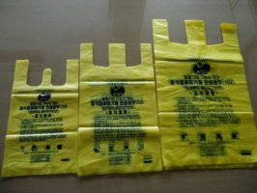
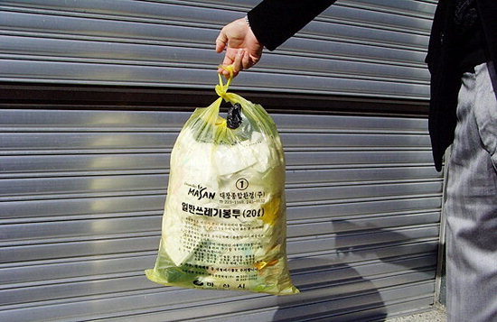
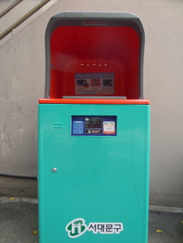
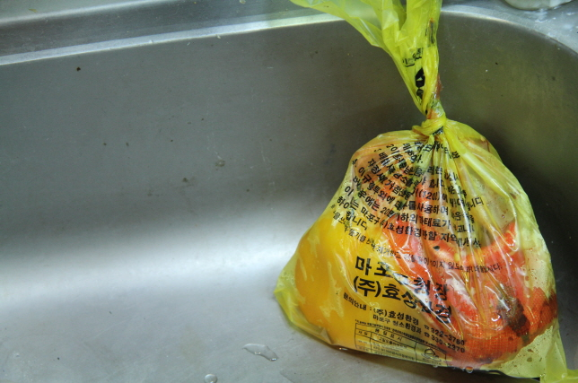
VBWF System – plastic bags

Slide 8
Extended Producer Responsibility System
Background | Base Law | Responsibilities | Weakness | Items
2003~ | Act on the Promotion of Savings and Recycling of Resources | Producer collects WEEE for free | Vehicles excluded | Refrig., TV, wash. machine, A/C, audio, mobile phone, PC
EEE regulated separately form 2008 | Article 16 | Collection upon purchasing new item | Rapidly changing tech products | printer, copier, fax machine added (2006~)
Producer Responsibility |  | Compliance with yearly recycling targets (%) | Only 7 types of WEEEs included | Packaging Containers
All stages of material flow | 90% of obliged producers are member of one PRO (KPRC) | “Recycling charge” when noncompliant |  | metal can, fluorescent lamp, lubricant, disposable bag, batteries
 |  | Korea Association of Electronics Environment |  | cleansers, styrofoam float, medicaments and cosmetics, anti-freezing solution

Slide 9
Eco-assurance System
Background | Base Law | Responsibilities | Weakness | Items
2008~ | Act on Resource of Electrical and Electronic Equipment and Vehicles | Collection of large WEEE free of charge any time | Unaccounted, unauthorized, informal sector | Home appliances, cars
To restrict hazardous materials | Article 15 | Compliance with yearly recycling targets (%->kg from 2014) | Illegal exporting, etc. | vending machine, personal computer, printer, copier, fax machine, mobile phone, audio
To facilitate recycling of EEE and vehicles | 90% of obliged producers are members of one PRO (KERC) | “Recycling charge” when noncompliant | Low recycling rate compared to EU | office appliance, electric water purifier, electric oven
 |  | Producers reveal WEEE toxicity (Cadmium <100ppm, other heavy metals<1000ppm) |  | electric rice pot, water softener, humidifier, electric iron, mixer, vacuum machine, video player
 |  | 95% recycling obligation rate for vehicles (from 2015) |  | microwave, food processing machine, dish drier, electric bidet, air purifier, electric heater
Notes:
M1 is the car under 9 seats
N1 is the car weighing less than 3.5 tons, replacement and spare parts.
http://tradenavi.or.kr/CmsWeb/viewPage.req?idx=PG0000000432&boardDataId=1480&CP0000000002_BO0000000052_Action=boardView&CP0000000002_BO0000000052_ViewName=board/BoardView
Lack of responsibility boundaries between stakeholders, especially in car recycling case. That issue was raised during the recent debate held in National Assembly on the car-related EPR responsibility.
http://www.kadra.or.kr/kadra/contents/sub04/04_05.html?BbsId=201031611475&idx_num=1741&mode=view

Slide 10
Target Management System for WEEE
Background | Base Law | Targets | WEEE Collection Channels
2014~ | Act on Resource of Electrical and Electronic Equipment and Vehicles | 2.9 kg/person (2013) | multiple collection channels including free household collection system for WEEE in major cities/nationwide
Per capita recycling target | Attachment 3 | 3.9 kg/person (2014) | Korea Electronic Recycling Cooperative, municipalies
To enhance recycling performance |  | 4.5 kg/person (2015) | Electronics shops
 |  | 6 kg/person (2018)
 |  | ←→ EU: 7.1kg/person (2010)
Notes:
M1 is the car under 9 seats
N1 is the car weighing less than 3.5 tons, replacement and spare parts.
http://tradenavi.or.kr/CmsWeb/viewPage.req?idx=PG0000000432&boardDataId=1480&CP0000000002_BO0000000052_Action=boardView&CP0000000002_BO0000000052_ViewName=board/BoardView
Lack of responsibility boundaries between stakeholders, especially in car recycling case. That issue was raised during the recent debate held in National Assembly on the car-related EPR responsibility.
http://www.kadra.or.kr/kadra/contents/sub04/04_05.html?BbsId=201031611475&idx_num=1741&mode=view

Slide 11
Stakeholder Responsibilities
Government
Corporations
Recyclers
Institutions:
Ministry of Environment,
Korea Environment Corporation,
Local Municipalities
Responsibilities:
To create relevant rules, yearly targets; track the performance of obliged parties
Institutions:
Producers/Importers –> recycling responsibility, Sellers & producers/importers-> collection responsibility
Responsibilities:
Take measures to recycle of WEEE; penalty=130% of recycling cost otherwise
Institutions:
Electronic equipment crushing recyclers, crushed residue recyclers, waste gas recyclers
Responsibilities:
To record information in EcoAS database on recycling volume
Notes:
In case the vehicle’s scrap value is higher than the collection cost of recycling, recyclers have larger responsibility in collecting the discarded vehicles. The opposite case stands as well.
http://tradenavi.or.kr/CmsWeb/viewPage.req?idx=PG0000000432&boardDataId=1480&CP0000000002_BO0000000052_Action=boardView&CP0000000002_BO0000000052_ViewName=board/BoardView

Slide 12
Recycling and Collecting Responsibilities
Recycling Responsibility
Manufacturer (previous year’s sales over ₩1 billion)
Importer (previous year’s sales over ₩0.3 billion)
Creates Collection System of WEEE (Article 5)*
Collecting Responsibility
Seller
(previous year’s sales over
₩5 billion)
Must Collect WEEEs for free upon purchasing new item (Article 16)*
*Source: Act on the Resource Circulation of Electrical and Electronic Equipment and Vehicles
Notes:
http://www.law.go.kr/%EB%B2%95%EB%A0%B9/%EC%A0%84%EA%B8%B0%C2%B7%EC%A0%84%EC%9E%90%EC%A0%9C%ED%92%88%20%EB%B0%8F%20%EC%9E%90%EB%8F%99%EC%B0%A8%EC%9D%98%20%EC%9E%90%EC%9B%90%EC%88%9C%ED%99%98%EC%97%90%20%EA%B4%80%ED%95%9C%20%EB%B2%95%EB%A5%A0

Slide 13
2. Performance and Evaluation of Korean EPR

Slide 14
Recycling obligation rate for WEEE
EEE | 2003 | 2004 | 2005 | 2006 | 2007 | 2008 | 2009 | 2010 | 2012 | 2013
Television | 11.6 | 9.2 | 11.8 | 12.6 | 13.3 | 14.5 | 16.0 | 19.0 | 27.2 | 36.2
Refrigerator | 9.0 | 10.8 | 14.1 | 16.9 | 17.3 | 18.9 | 20.6 | 22.1 | 26.7 | 34.3
Washing Machine | 25.3 | 21.8 | 21.2 | 23.4 | 24.2 | 25.3 | 26.1 | 27.4 | 31.7 | 38.8
Air conditioner | 0.7 | 0.7 | 3.6 | 1.7 | 1.9 | 2.1 | 2.3 | 2.4 | 2.7 | 8.8
PC | 3.8 | 5.4 | 8.5 | 9.4 | 9.8 | 10.3 | 11.1 | 12.3 | 15.3 | 22.9
Audio | - | - | 10.2 | 12.7 | 13.1 | 14.9 | 15.5 | 17.0 | 20.0 | 26.8
Mobile phone | - | - | 11.9 | 15.4 | 16.5 | 18.0 | 19.8 | 22.0 | 35.6 | 39.9
Printer | - | - | - | 8.4 | 9.2 | 11.2 | 11.9 | 13.0 | 15.0 | 21.8
Copier | - | - | - | 8.4 | 9.4 | 12.7 | 13.3 | 14.2 | 16.0 | 23.4
Fax machine | - | - | - | 8.4 | 9.4 | 11.4 | 12.1 | 13.4 | 15.6 | 22.3

Slide 15
WEEE Recycling by Year

Slide 16
Recycling Rate by Type
Source: Korea Environment Corporation(internal source, 2015)

Slide 17
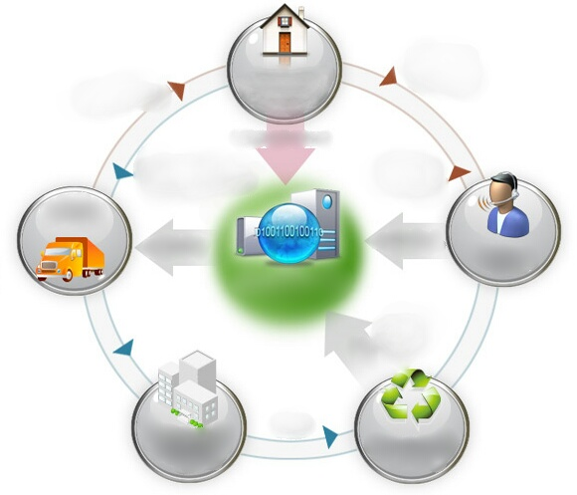
WEEE Free Collection system
1. Call for collection
4. Collection Date Check
Target
Large electronic appliances
Small electronic appliances
cannot be collected unless
consumer discards over 5 small appliances at a time
Collection is performed on Tuesdays, Thursdays and Saturdays
15% of WEEE are collected from KERC (35,172 units of collected wastes in 2014)
Consumer
5. Home Collection
(using PDA)
Online Reservation
7. Collection Completion Call
Public Vehicles
3.Transportation Reservation
2. Reservation Reception
Call center
Disposal Reservation
System
8. Stock Registration
6. Transporting
Municipality
Recycling center
Notes:
http://www.edtd.co.kr/xuSvc/introduction/introduce.jsp

Slide 18
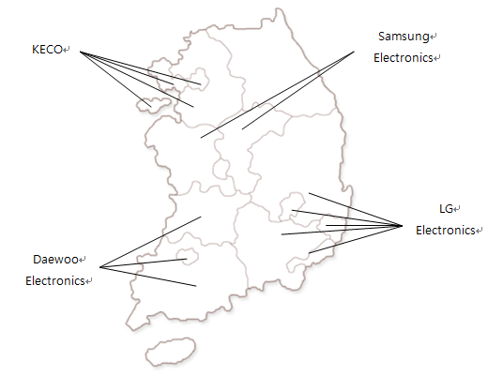
WEEE Logistics Infrastructure
<WEEE Collection Map of Korea>
Even before WEEE legislature was passed, Korean companies had been operating region-based collection logistics
The remaining 30~40% of e-wastes are collected by municipalities
Source: POSA (2009)
Notes:
http://www.edtd.co.kr/xuSvc/introduction/introduce.jsp

Slide 19
Samsung WEEE Recycling History
Voluntary Agreement with the Korean Government
(Creation of Regional Recycling Centers and WEEE Recycling Association)
Supply of Small WEEE to Social Enterprises(Recycler) for free
13 Recycling Centers
(8 for Large WEEE, 5 for Small WEEE )
First WEEE Recycling Center in Asan
Announcement of New Consumer Rights (Environmental Protection)
Establishment of free collection logistics
present
05’
00’
98’
95’

Slide 20
Company-led WEEE Recycling
Samsung
Constructed the first large-scale automatic recycling center(RC) in Asan City(1998)
Collects WEEE at digital plazas and service centers
LG
Constructed recycling facility for refrigerators and washing machines(2001)
Collects WEEE through “Best Shops” and service centers
In 2007, Samsung Electronics and LG Electronics operated 439 collecting points with combined collected WEEE accounting for 65~85% of the total WEEE amount
Notes:
http://samsungtomorrow.com/%EC%84%B8%EA%B3%84-%ED%99%98%EA%B2%BD%EC%9D%98-%EB%82%A0-%ED%8A%B9%EC%A7%91-%EC%84%9C%EC%9A%B8%EC%8B%9C%EC%97%90%EC%84%9C-%EB%B0%B0%EC%B6%9C%EB%90%98%EB%8A%94-%ED%8F%90%EC%A0%84%EC%9E%90%EC%A0%9C
https://www.lge.co.kr/lgekr/company/about/sustainability/environment/end-of-life-products.j네
http://www.samsung.com/sec/support/digitalplaza/pickup_service.html
http://www.samsung.com/uk/mobile/green-management/information/eco.html

Slide 21
Issues in Bulgarian WEEE management system
Mixed Municipal Solid Waste (only 180 municipalities have separate packaging waste collection)
Environmental Hazards (health risk from unauthorized dismantling)
Lack of control over Household Waste Activities (discard WEEE into municipal waste or leave by containers)
Insufficient Recycling and Criminal Activities
(not knowing the origin or waste promotes burglary; focus on valuable recyclables leaves less valuable items not recycled)
System
Regulation
Culture & Education
Economic Incentive
Informal Sector (pick
WEEE from containers)
Lack of Environmental Education & Information (limited group target; inconsistent environmental information by PROs; public is misinformed about recycling)
Lack of Compensation for Transportation Costs and Discomfort (5-10 BGN per piece is not enough motivation; reuse of WEEE)
Property-based Tax to Sponsor WEEE Collection (disproportionally small burden of households )
Attachment to Old EEE (due to post-Soviet sentiment)
Notes:
http://samsungtomorrow.com/%EC%84%B8%EA%B3%84-%ED%99%98%EA%B2%BD%EC%9D%98-%EB%82%A0-%ED%8A%B9%EC%A7%91-%EC%84%9C%EC%9A%B8%EC%8B%9C%EC%97%90%EC%84%9C-%EB%B0%B0%EC%B6%9C%EB%90%98%EB%8A%94-%ED%8F%90%EC%A0%84%EC%9E%90%EC%A0%9C
https://www.lge.co.kr/lgekr/company/about/sustainability/environment/end-of-life-products.j네
http://www.samsung.com/sec/support/digitalplaza/pickup_service.html
http://www.samsung.com/uk/mobile/green-management/information/eco.html

Slide 22
System-Related Experiences of Korea
Junkyards Business Law (1962)
Entitle Police with the power to monitor activities of junkyards
Junkyard owner is required to report the type of products he/she handles, must not have history of imprisonment in past 3 years to get permit
Waste Management Law (Act No. 10389, Jul. 23, 2010)
-Junkyards over 1000m² in metropolitan and 2000m² in other areas are required to be equipped with environmentally friendly facilities for legal dismantling
Financial Support for Junkyards’ Environmental Facilities
- Currently considered by the Ministry of Environment
Junkyards in Korea are not Allowed to collect or Dismantle WEEE
-They are allowed to handle only plastic, paper and iron scraps
Notes:
http://www.edtd.co.kr/xuSvc/introduction/introduce.jsp

Slide 23
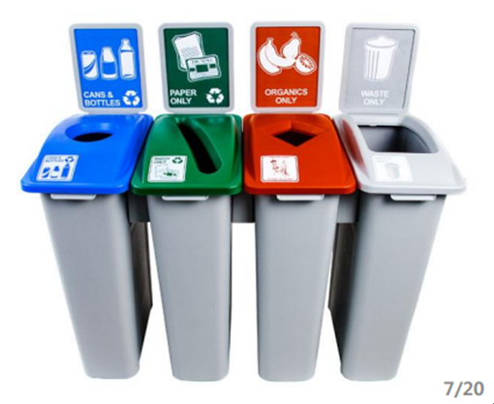
Regulation-Related Experiences of Korea
Designated and Monitored Disposal Location
Every apartment complex has a security guard that oversees and explains disposal procedure on designated days of week
Security cameras are installed and only people living in that apartment complex are allowed to dispose of their trash
Illegal disposal is penalized by fine up to KRW1,000,000 (about $850)
Designs for Separate Waste Collections
Notes:
http://www.edtd.co.kr/xuSvc/introduction/introduce.jsp

Slide 24
Culture and Education-Related Experiences of Korea
Environmental Education is Part of General Curriculum
- From 1995 environmental education is formally included in elementary, middle and high schools
- Environmental education is an elective class in middle schools
- Every school requires students to take turns in recycling of waste produced at school
Undergraduate and graduate degrees in environmental-related fields are offered by leading universities
A single PRO facilitates complete and consistent information delivery to households
No to Little Attachment to Old Electronics is Present
No incentive for households to keep old appliances when spaces are limited, while free WEEE collection system provided by large electronics companies is available
- Households simply do not feel the need for keeping old, malfunctioning appliances
Notes:
http://www.edtd.co.kr/xuSvc/introduction/introduce.jsp

Slide 25
Economic Incentive-Related Experiences in Korea
From Property-based Tax to Volume-based Tax
- From 1980s to 1995 Korea used property-based tax to fund waste management
- Property-based tax does not give incentive for consumers to reduce waste and dispose carefully
- Volume-based bags come in sizes from 3l to 100l and prices range from KRW71 to KRW2,285 as of 2013
Consumers’ share of cost in implementing volume-based fee system was 24.9% in 2013
From 1995 to 2009, the policy saved KRW 10,711,424 million in direct landfilling and incineration costs
Very few to No Street Containers
- To motivate “pay as you throw policy,” municipal governments reduced the number of street containers from 7,600 to 3,700 in Seoul
Notes:
http://www.edtd.co.kr/xuSvc/introduction/introduce.jsp

Slide 26
Main Policy Recommendations
Issue Type | Summary
System | Laws restricting the type of waste, allowed collection location, environmental dismantling requirements for junkyards Initial financial support for junkyards that want to obtain legal permit for dismantling activities
Regulation | Re-evaluate location and reduce amount of curbside containers Enforce supervision (security guard, surveillance cameras, designate recycling waste day of the week)
Culture & Education | Make recycling a culture at schools through recycling days Ensure the exposure to environmental issues from kindergarten Promote information dissemination of potential energy and health risks in regard to the extended use and storage of old appliances
Economic Incentives | Shift to volume-based waste fee system Make monetary compensation more attractive (Consider subsidy for handing over old appliances, e.g., Early retirement program, Low Pollution Program for Diesel Vehicles in Korea) Promote free collection by phone call or online
Notes:
http://www.edtd.co.kr/xuSvc/introduction/introduce.jsp

Slide 27
4. Further Analysis of Household-level
Consumption Behavior on EEE in Bulgaria:
Preliminary Evidences from the World Bank
Survey Data

Slide 28
Data: Bulgaria Multi-topic Survey 2007
Item | Summary
Producer | Gallup International Bulgaria
Publisher | World Bank – Multitopic Household survey 2007 from Living Standards Measurement Study (Household survey program by World Bank)
Characteristics | The fifth living standards measuring survey conducted in Bulgaria 4,300 randomly selected households via three-stage probability sampling procedure with stratification by urban and rural areas and by region households
Assumptions | . Includes household description, migration, health, employment, agriculture, consumption and other valuable information Contains information on household structure, family members, ownership of electronic products, product age, desirable resale price (as stated by the household head), method of acquiring the products, etc.
Purpose | To better understand consumption behavior including possible product attachment on home appliances by Bulgarian households To compare the results with other countries including Korea
Notes:
http://www.edtd.co.kr/xuSvc/introduction/introduce.jsp

Slide 29
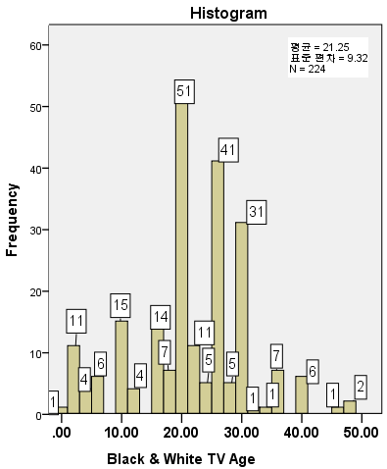
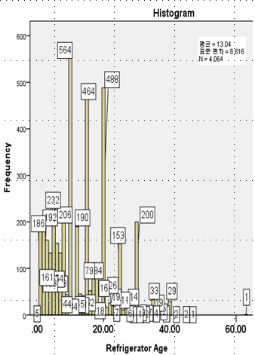
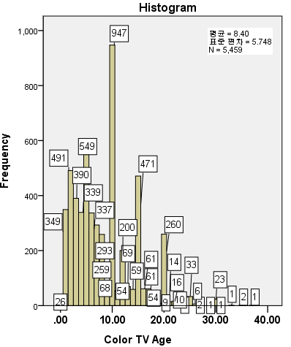
Characteristics by Electronics in Bulgaria
Need to consider household characteristics for effective WEEE collection and promotion activities
Notes:
http://www.edtd.co.kr/xuSvc/introduction/introduce.jsp

Slide 30
Average Product Age of EEE in Korea
Product Age (years) | TV | Washing Machine | Air Conditioner | PC Mainframe | PC Monitor | Mobile Phone | Audio | Printer
1 | 2.8 | 3.6 | 7.9 | 7.5 | 8.6 | 6.3 | 9.8 | 7.3
2 | 2.5 | 1.6 | 3.2 | 15.2 | 9.5 | 29.4 | 2.3 | 16
3 | 5.2 | 3.3 | 14.8 | 23.3 | 24.6 | 34.3 | 11.7 | 23.4
4 | 4.6 | 3.8 | 6.7 | 17.1 | 16.8 | 21.3 | 7.4 | 12.2
5 | 10.5 | 12.1 | 22.9 | 22.6 | 26.3 | 0 | 14.3 | 18.2
6 | 9.7 | 3.6 | 5.6 | 5.9 | 5.8 | 0 | 2.2 | 7.6
7 | 8.8 | 11.7 | 8.1 | 3.1 | 2.3 | 0 | 7.9 | 5.5
8 | 11 | 11.5 | 4.9 | 1.3 | 1.6 | 0 | 8.6 | 2.9
9 | 17.8 | 10.1 | 3 | 2.1 | 2.4 | 0 | 4.6 | 4.1
over 10 | 27.1 | 38.7 | 22.9 | 1.9 | 2.1 | 0 | 31.2 | 2.8
average | 7.33 | 7.65 | 5.85 | 3.94 | 4.06 | 2.53 | 6.41 | 4.21
Source: KAEE survey (2006)
Notes:
http://www.edtd.co.kr/xuSvc/introduction/introduce.jsp

Slide 31
Relationship between the Number of Products and Product Age
Notes:
http://www.edtd.co.kr/xuSvc/introduction/introduce.jsp

Slide 32
Relationship between the Number of Products and Product Age
Need to consider household characteristics for effective WEEE collection
and promotion activities

Slide 33
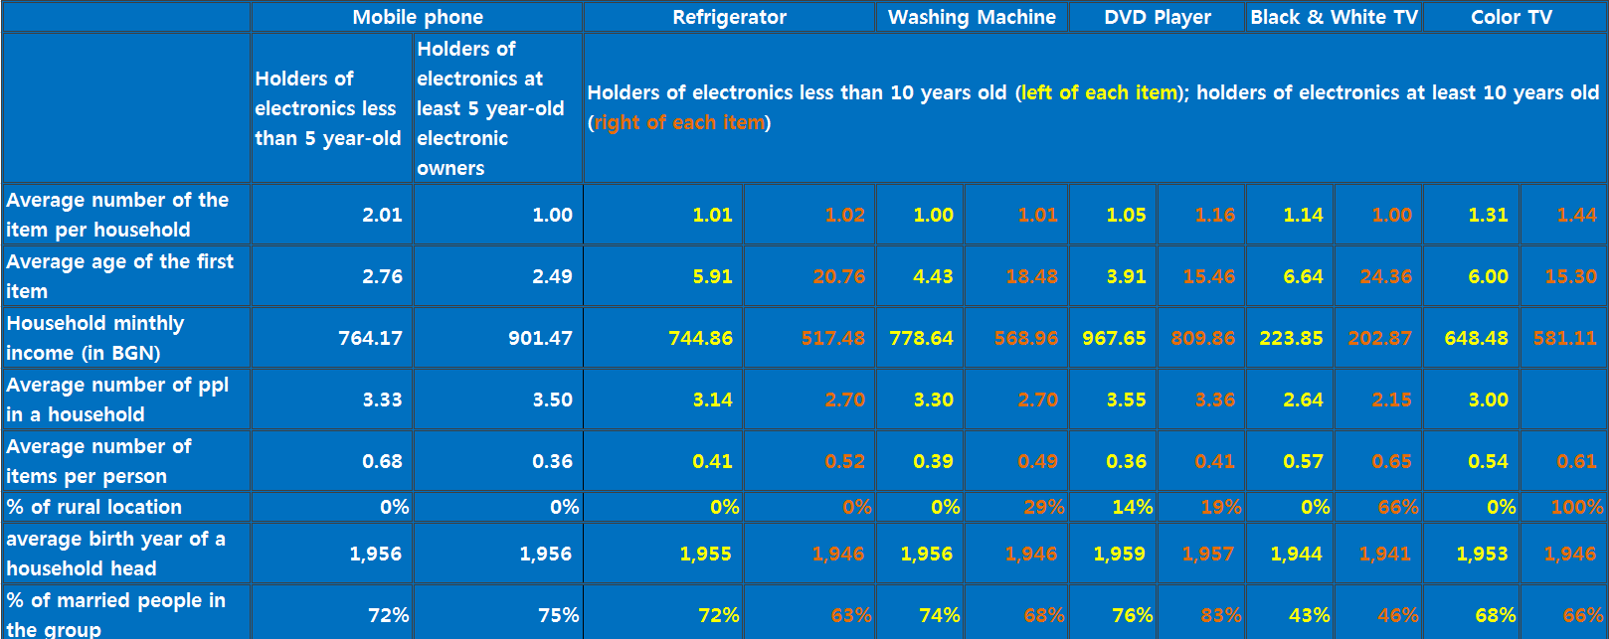
Household Characteristics by Electronics Type
Need to consider household characteristics for effective WEEE collection
and promotion activities
Notes:
http://www.edtd.co.kr/xuSvc/introduction/introduce.jsp

Slide 34
Product Age of TVs in a Household in Korea
Source: KISDISTAT
Household level survey conducted by Korea Media Panel Research (2010)
Sample size of 3,085 households
Face-to-face interview to extract information of about household characteristics
Notes:
http://stat.kisdi.re.kr/MediaPanel/MediaPanel_Outline.aspx

Slide 35
Number of TVs in a household (per income, per number of people)
Source: KISDISTAT (Korea Media Panel Research, 2010)
Average number of persons per household
Bulgaria : 2.6 persons(2005) → 2.4 (2014) (Source : Eurostat)
Korea : 2.69 (2010)
Notes:
http://stat.kisdi.re.kr/MediaPanel/MediaPanel_Outline.aspx

Slide 36
5. Concluding Remarks

Slide 37
Concluding Remarks
This study is the result of a close research collaboration between Bulgarian and Korean experts devoted to an in-depth analysis of issues on EPR for WEEE in both countries.
The goal of the study is to share experiences of both countries in waste management policies to promote circular economy.
We hope that knowledge sharing on the case of Korea in environmental policy, i.e., historical development of waste management policy and current status/issues in implementing EPR for WEEE, can benefit the people, industry, and the government of Bulgaria.
Notes:
http://www.edtd.co.kr/xuSvc/introduction/introduce.jsp

Slide 38
Conclusions
We acknowledge the differences in economic and market conditions and governance systems between Bulgaria and Korea, which should be taken into account in considering policy options.
A successful implementation of waste management policies will depend on understanding historical and cultural background as well as identifying political and economic contraints and opportunities of a given society.
Notes:
http://www.edtd.co.kr/xuSvc/introduction/introduce.jsp

