Slide 1
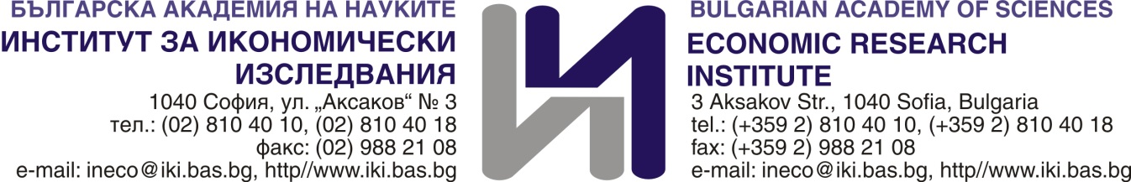
Economic Research Institute
The Bulgarian center for research on China economy and cooperation

Slide 2
Center for the study of Asian Economies:
The mission
To contribute to the development of economic cooperation between Asian countries and Bulgaria by conducting innovative research in the field of economics, implementation of joint research projects and programs with partner institutions from Asian countries, as well as with national academic and research centers or other organizations interested in strengthening economic cooperation with this region

Slide 3
Activities
Creation of information databases for researchers and experts in the field of Asian economies from external institutions and organizations in Bulgaria; the partner institutions from Asia; publications and research in the field of Asian economies
Gathering together all the experts and accumulating expertise on China and other Asian Countries
Cooperation and preparation of joint projects with partner academic institutions
Encouraging joint publications of project results.
Formation of an information database with economic information and expertise for the benefit of potential investors in Bulgaria and Bulgarian companies with interests abroad
Organization of public lectures with the participation of scientists and businesses.
Organization of scientific forums
Supporting the exchange of doctoral students.

Slide 4

Partnering institutions
Korean Development Institute, Three projects financed by the Knowledge sharing programme (KSP) of Korean Government
Memorandum of Understanding with the Korea Institute of Industrial Economics and Trade and - 24.02.2015: provides for financing and conducting joint projects, exchange of information and doctoral students to expand the expertise and research capacity of the two economies for the benefit of business and accelerating trade and economic cooperation
Memorandum of Understanding with the Vietnam Economic Institute at the Vietnam Academy of Social Sciences - 09.10.2015: cooperation in the field of macroeconomic analysis and policies, the development of the financial sector, regional development, restructuring and the development of agriculture , the common European market, foreign direct investment, etc. not only in the scientific field, but also in support of Bulgarian and Vietnamese business. Published 20 articles in the Research Journals

Slide 5

Cooperating with China’s institutions
Memorandum of Understanding between the Institute of Economics at the BAS and the Institute for Economic Research at the Chinese Academy of Social Sciences - 11.09.2018: provides for joint research, publication and training activities in the economic field, discussion of a two-year action plan with specific initiatives focused on supporting of the realization of the joint priority Bulgarian-Chinese investment projects and the processes within the framework of the "16+" initiative
In accordance with Art. 2 of the Memorandum of Understanding between the Republic of Bulgaria and the People's Republic of China approved by the Government to promote the creation of the Global Center for Partnership of the CEE countries and China within the framework of the "16+1" initiative, the Institute has been designated as a joint management partner and the Chinese Institute for International Studies at the Ministry of Foreign Affairs of the People's Republic of China of the Global Center for Partnership planned to be established in Sofia as a joint body and mechanism for cooperation of the "think-tank" type

Slide 6

Cooperating with China’s Institutions
MoU between ERI/BAS and the Institute for development Studies at Fudan University - 08.10.2018 г.; exchange of three visits, Shanghai Forum
Shanghai Hongqiao Forum

Slide 7

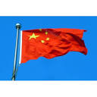
CHINA MEDIA
China Daily (Global Edition)
China Investment
China Radio International)

Slide 8
What we have achieved
Focus on China’s economy research in the international economy studies
Research project “Trade and economic relations between China and Bulgaria”
Published book on China's economy and cooperation
Other publications and articles
Publishing articles focusing on China’s role in the world economy in the Икономически изследвания/Economic Studies Journal

Slide 9

Ideas for future joint research: ERI could do:
Analysis of current an prospective EU legislation as regards investment and import from China
Report on the prospective project areas for investment from China
Analysis and identification of instruments for shortening the supply chains from China
Green transition and the role of China in the global green trade

